Slide 1
EDDMapS Pro – Is this invasive species mapping tool right for your program?
Rebekah D. Wallace and Charles Bargeron
University of Georgia
Center for Invasive Species and Ecosystem Health Tifton Georgia USA

Slide 2
The National Platform for Invasive Species Early Detection and Mapping

Slide 3
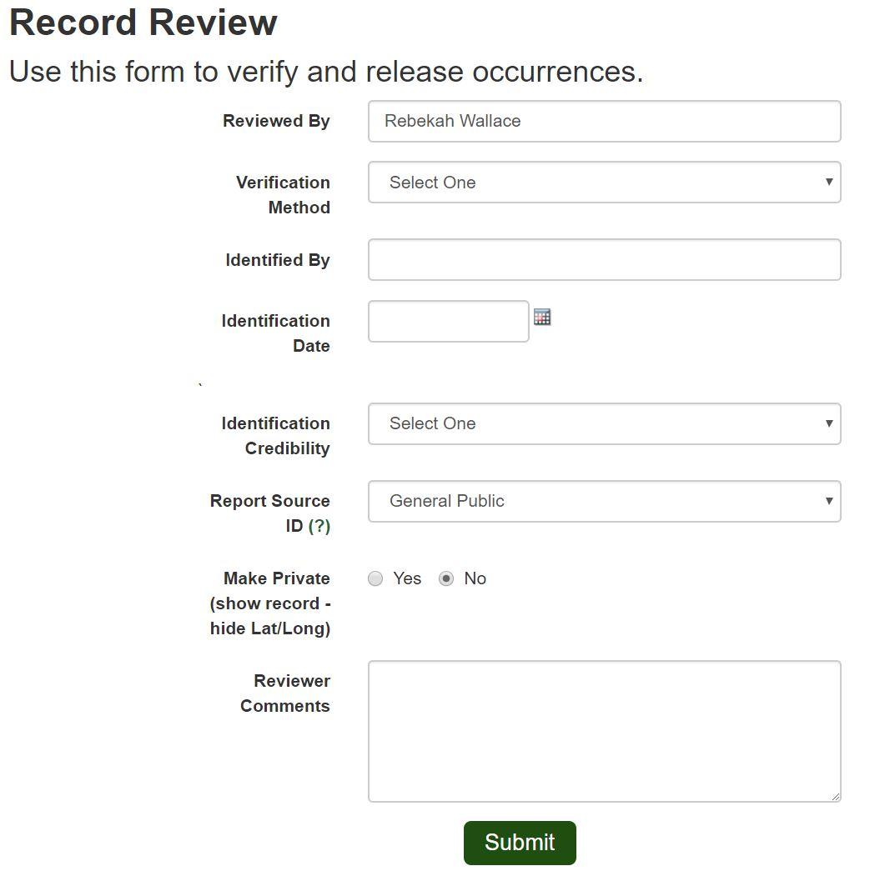
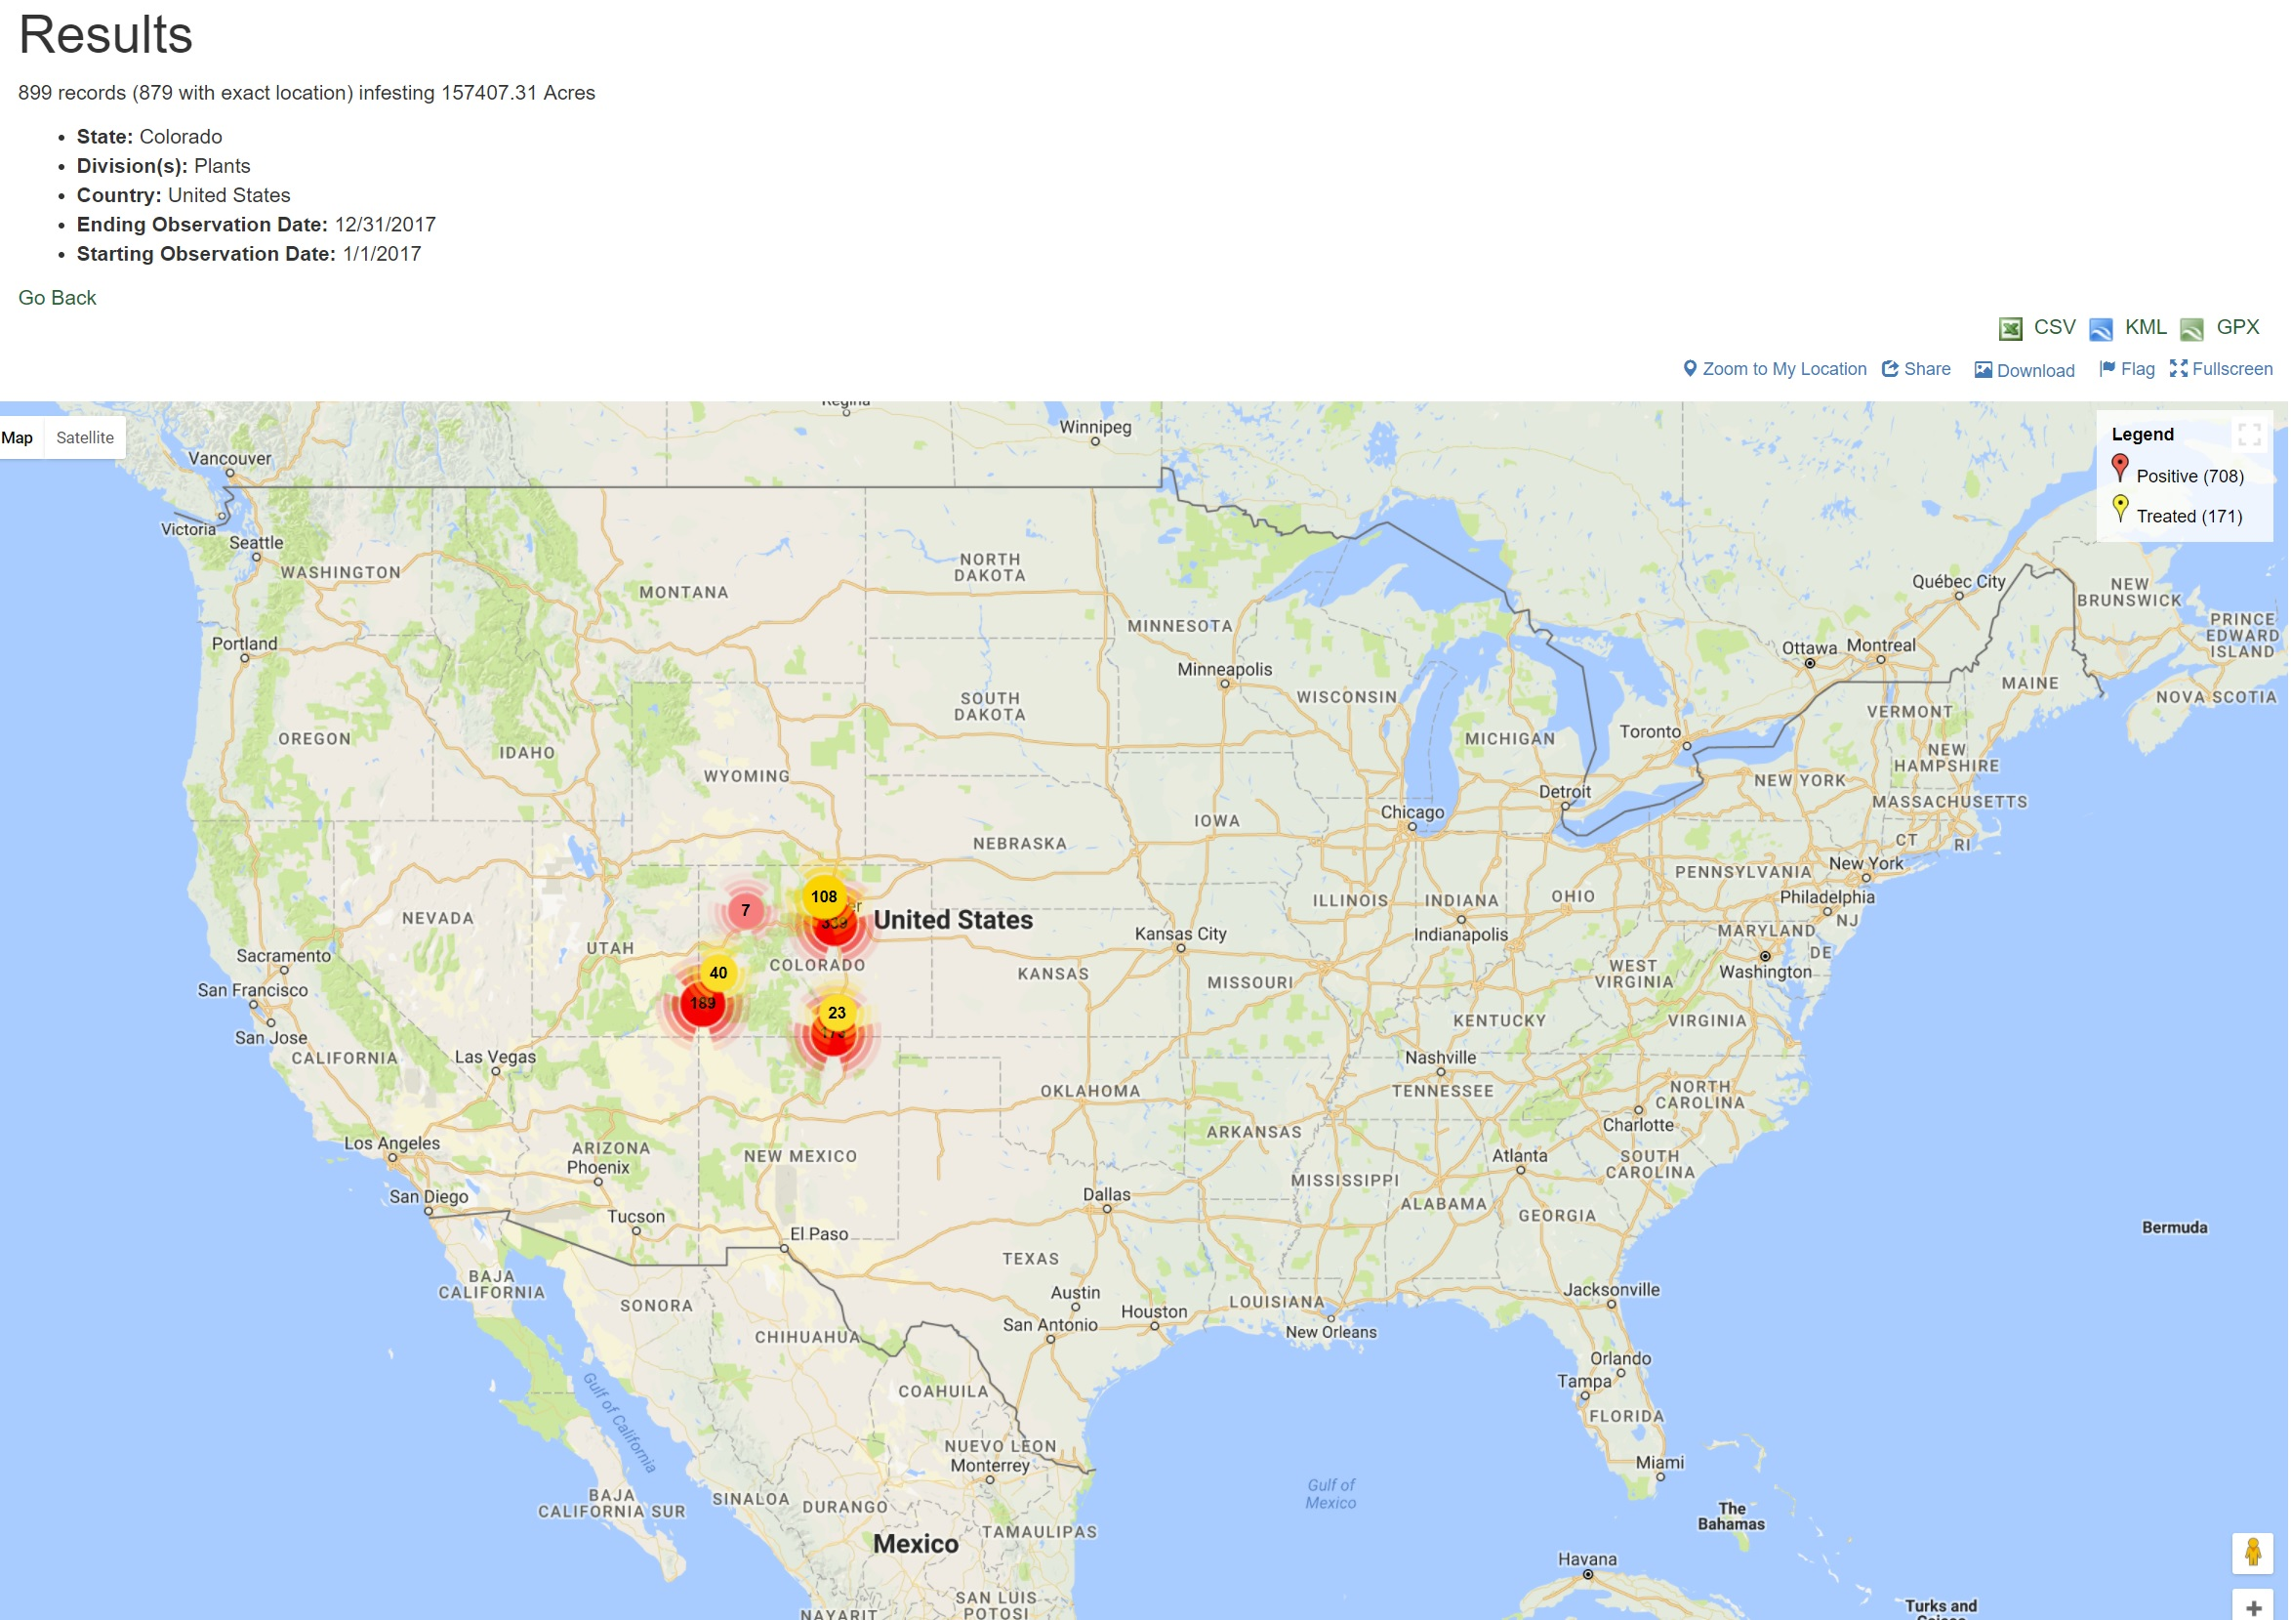
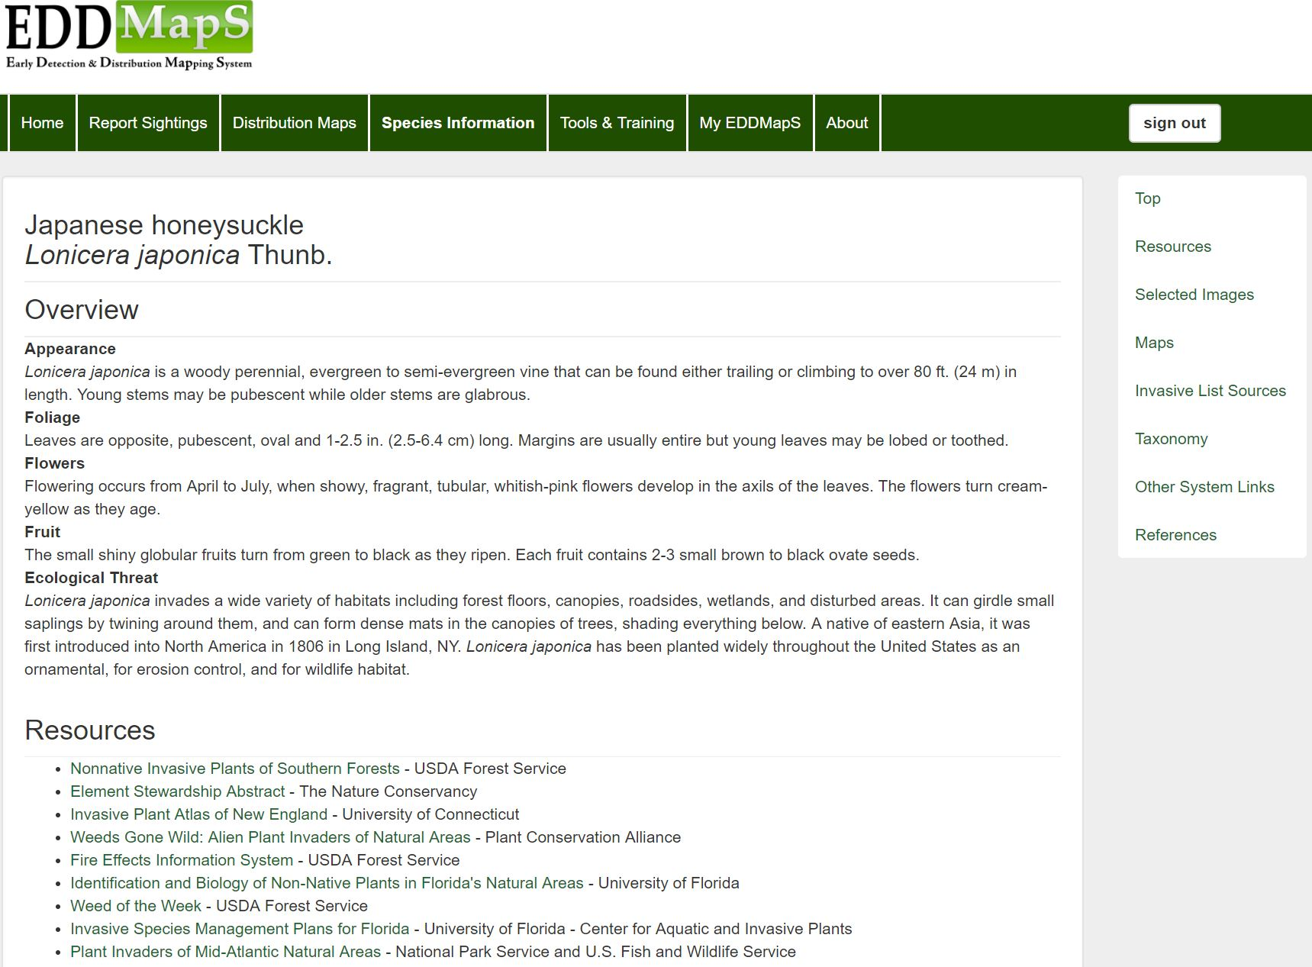
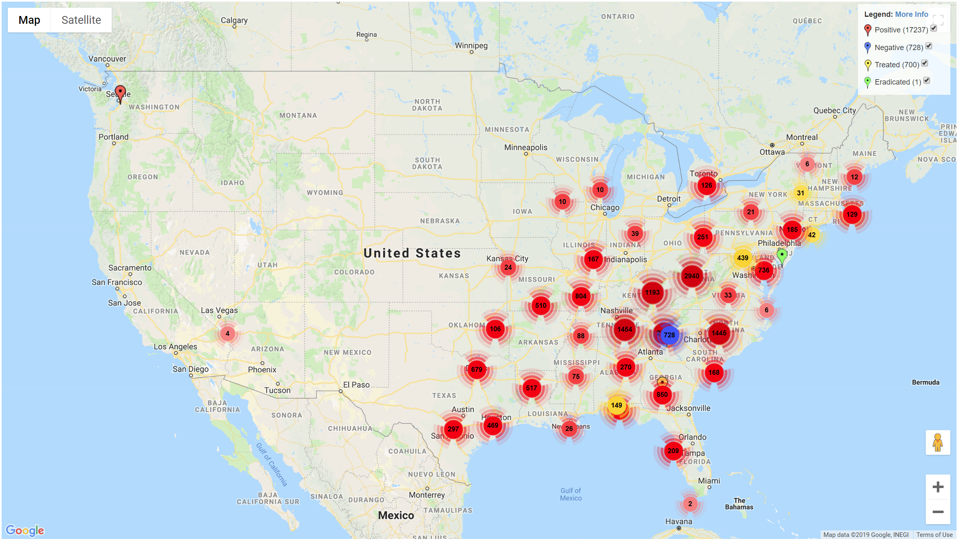
Elevator Pitch of EDDMapS
Data Collection Tools
Data Verification Process
Species Information
Maps (State, County, Point)
Data Available for Download
Reports
Reuse/Analysis

Slide 4
Sources of EDDMapS Data
USDA NRCS PLANTS Database
Biota of North America Program
Flora of North America
Invasive Plant Atlas of MidSouth
Herbaria/Museums
Global Invasive Species Information Network
Nonindigenous Aquatic Species
Federal Agency Databases
State Agencies
Regional Programs
Academic Institutions
Trained Citizen Scientists
Homeowners

Slide 5
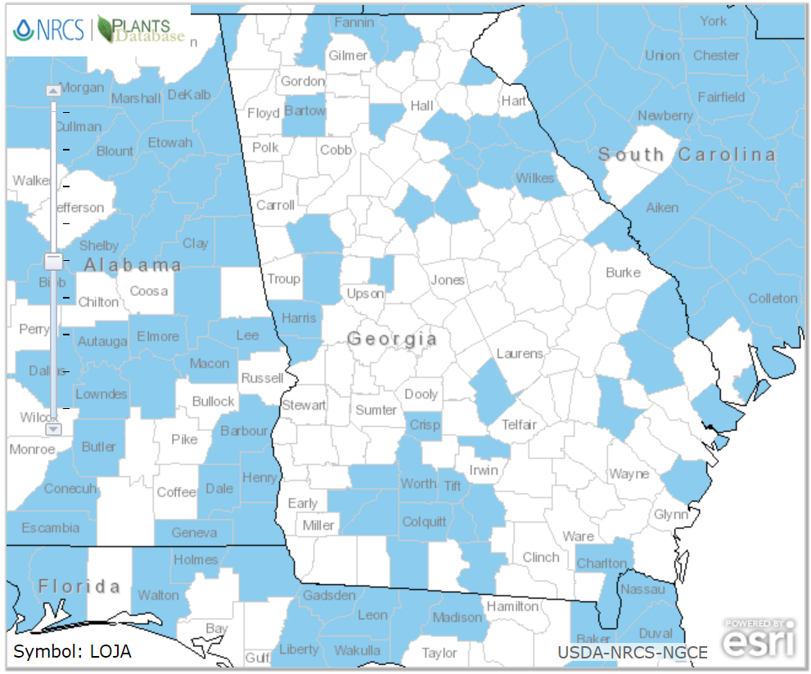
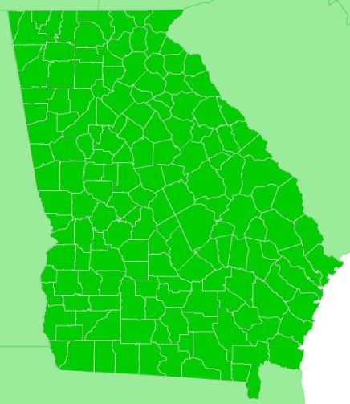
Aggregated Distribution Maps
Japanese Honeysuckle Distribution in Georgia from
USDA PLANTS Database – March 2019
Japanese Honeysuckle Distribution in Georgia from
EDDMapS Database – March 2019

Slide 6
Why Smartphones?

Slide 7
Traditional Data collection
Paper and Pencil (and GPS device, camera, etc.)
Error Prone
Initial transcription error (e.g., GPS coordinates, quantifications, date, etc.)
Transcription to database
Costly (long term)
Transcription cost
Data Cleaning
Retraining
Standardization – dependent on recorder

Slide 8
Electronic Data Collection
Tablet/Smartphone into a form/app
Design/Programming can prevent most errors
Contradictory info not able to be entered
Auto-capturing some data (e.g., date, location, etc.)
Training – high acceptability after training
Standardization
Metadata
Data sharing/accessibility/analysis

Slide 9
Cellphone Adoption Over Time
Pew Research Center: Surveys conducted 2002-2018 https://www.pewinternet.org/fact-sheet/mobile/

Slide 10
Smartphones are Not just for “the Kids”

Slide 11
Skip Snow, National Park Service, Bugwood.org

Slide 12
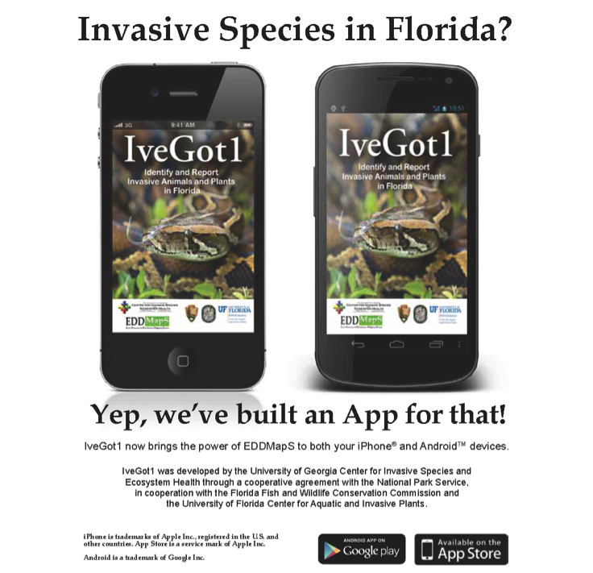

Slide 13
How Does It Work?

Slide 14
New Report
Single Reports
Web Forms
Smartphone Apps
Bulk Data
One Time Dumps
Embedded Web Forms
Data Sharing Partners
GISIN Mirror
Reporting API

Slide 15
New Report
Regulated
State Agency Contact
Federal Agency Contact
Not regulated
Species Verifier
Location Verifier
Project Verifier
No Verifier
EDDMapS Admin
State Verifier
County Verifier
Park/Site Verifier
CISMA/CWMA Verifier

Slide 16
Verified and Released Report
Users Alerts
By Species
By Location
Maps
State Distribution
County Distribution
Data Feeds
GISIN
Recent Reports RSS
By Project
API
Google Point Maps
ArcGIS
Custom Maps

Slide 17
Has It Worked?

Slide 18
All App Downloads

Slide 19
EDDMapS Florida Statistics
What were the reports?
Overall

Slide 20
EDDMapS Florida Statistics
What were the reports?
Smartphones

Slide 21
Observations Sent to EDDMapS By Year

Slide 22
The Two Options
SEEDN
EDDMapS Pro
Designed for Volunteers, Citizen Scientists, Casual Observers, etc.
Field Guide embedded in app
Record data, saved locally on phone
Must have mobile service to view existing data
Data not downloadable
No revisit record option
Upload when you have wireless signal
Designed for professionals to use in low/no mobile signal areas
No embedded field guide in app
Record data, saved locally on phone
Downloadable data sets (by county)
View records offline, in the field
Revisit existing records
Upload when you have wireless signal

Slide 24
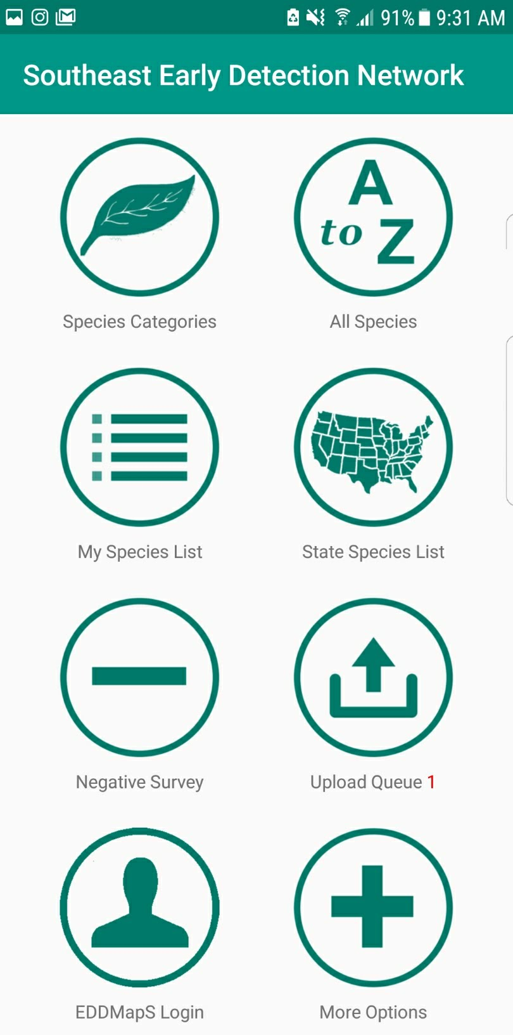
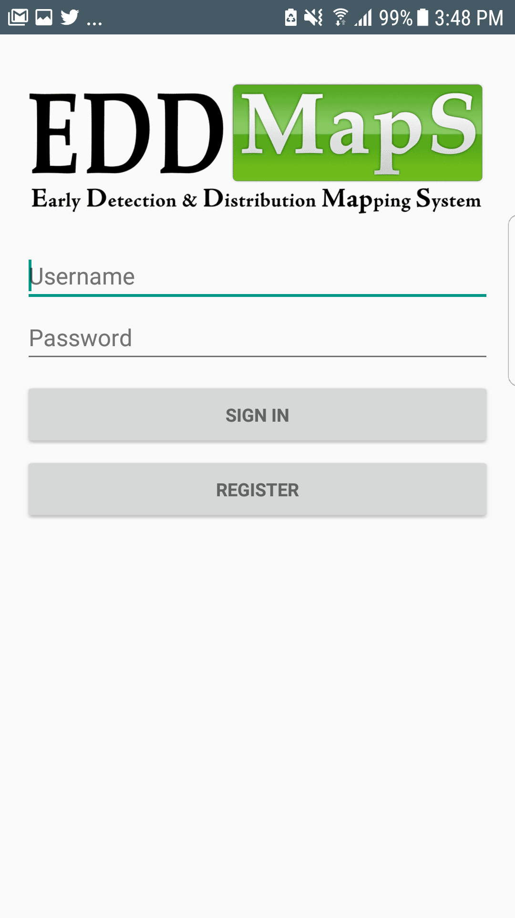

Slide 25
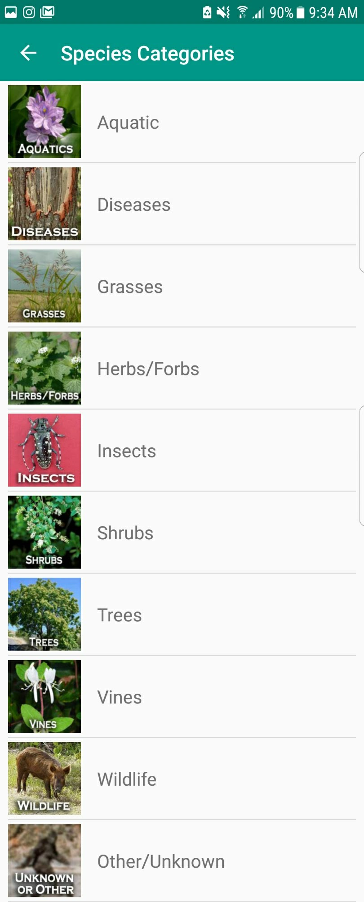
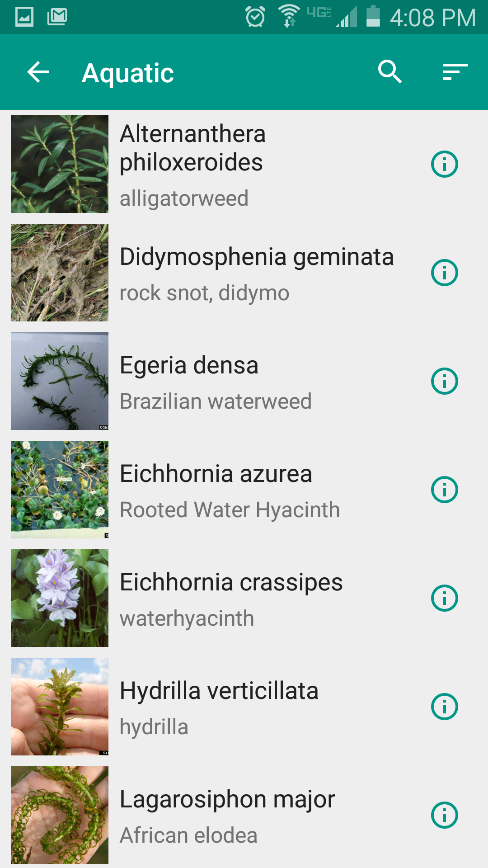

Slide 26
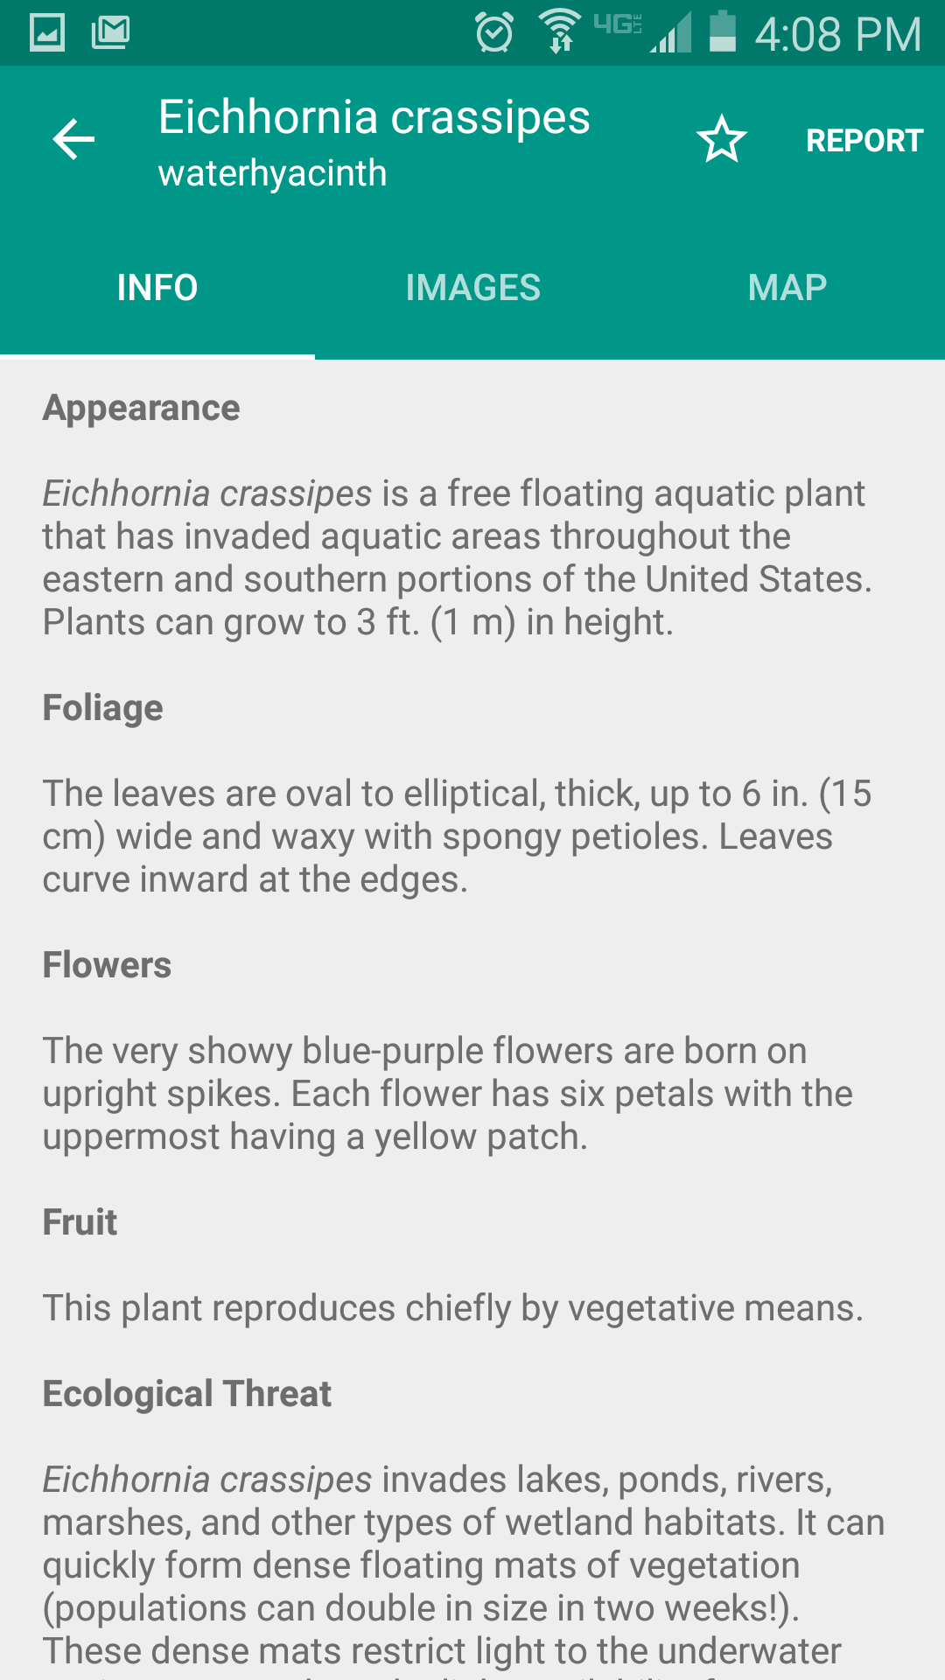
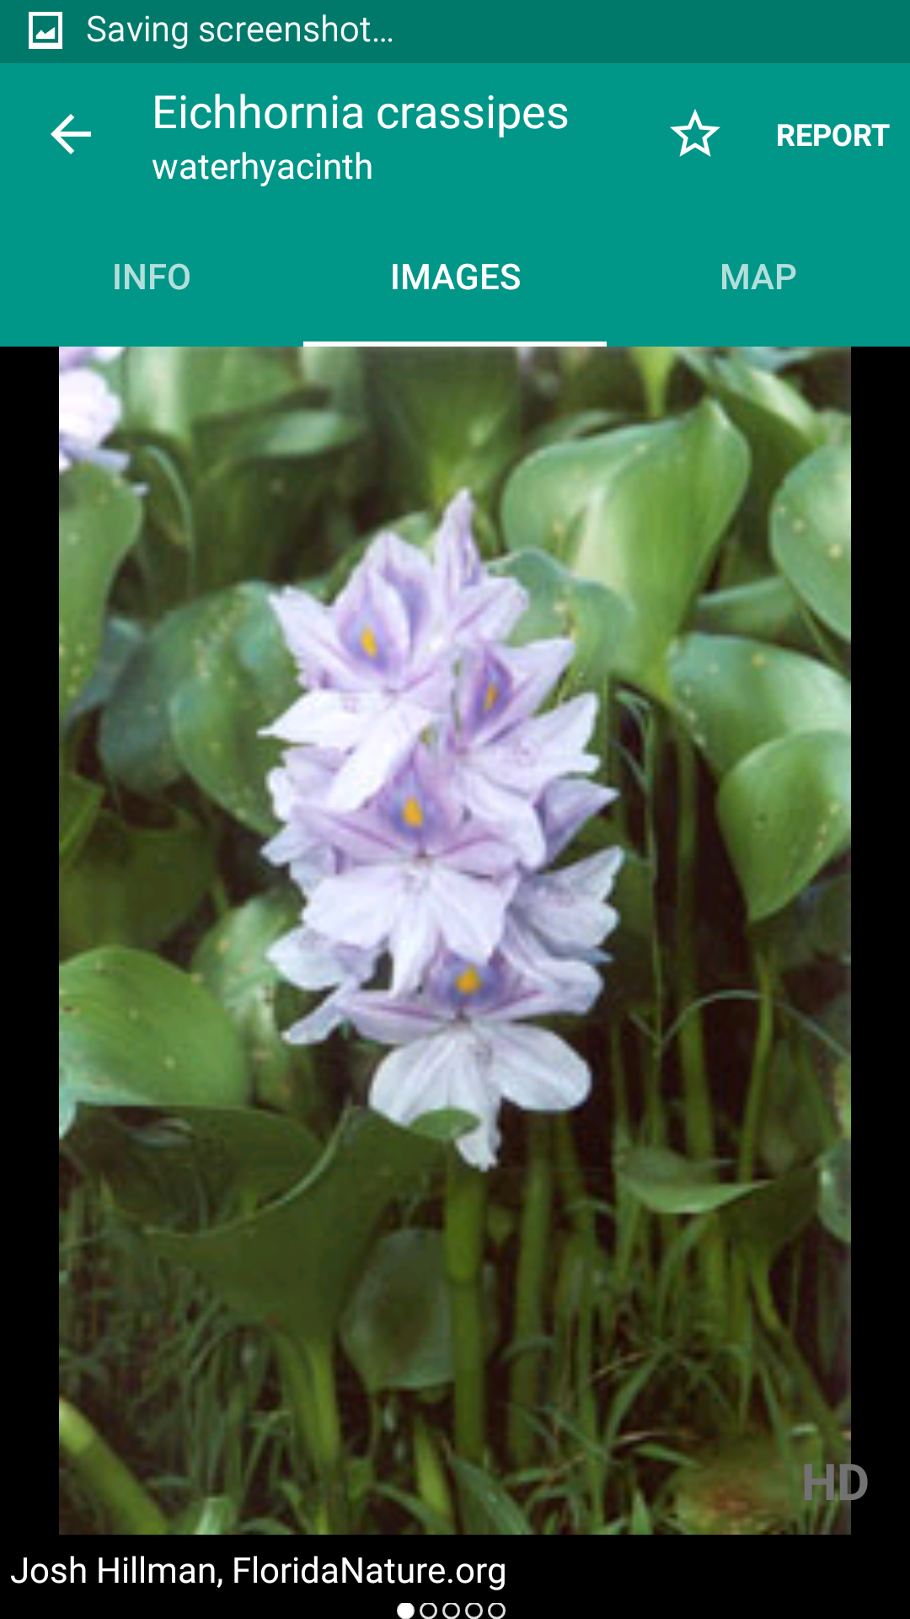

Slide 27
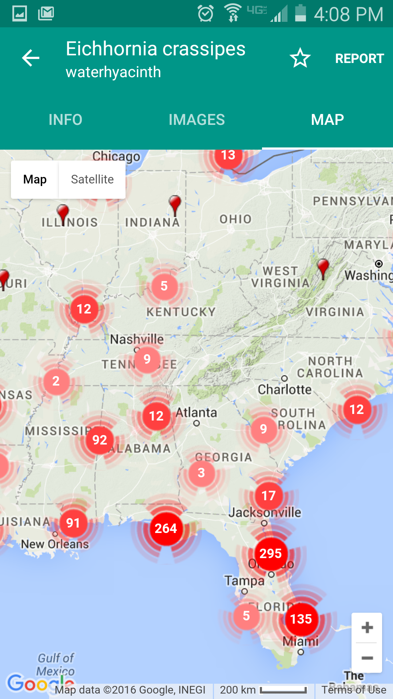
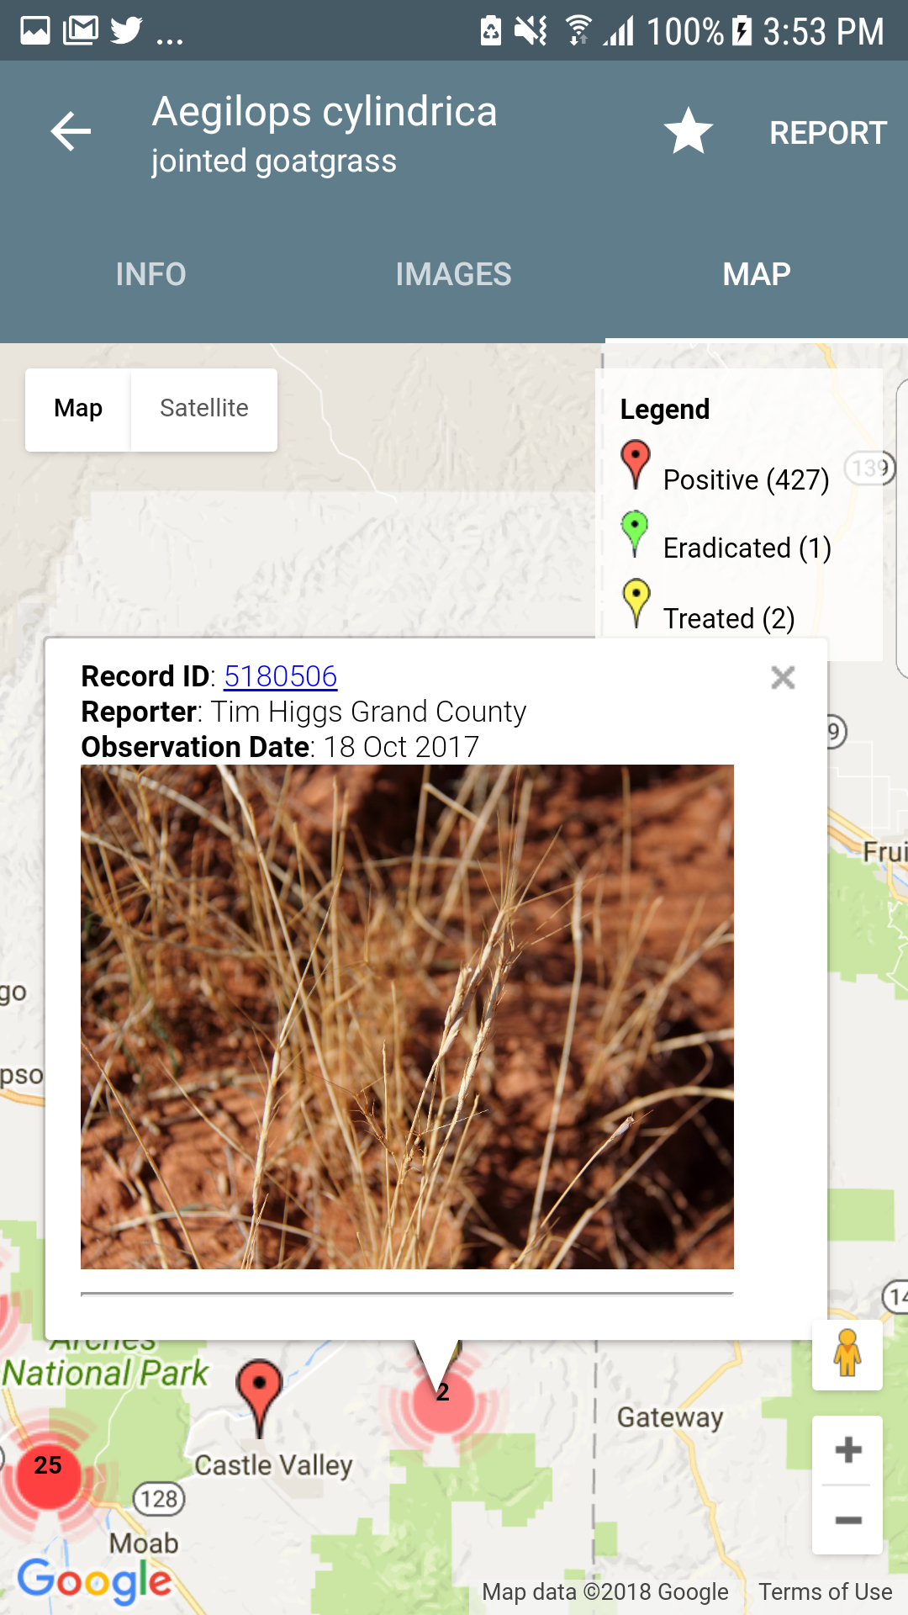

Slide 28
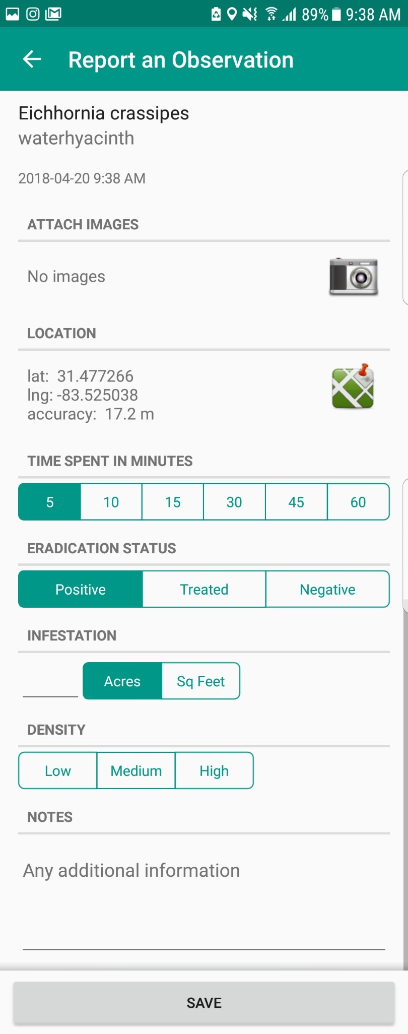
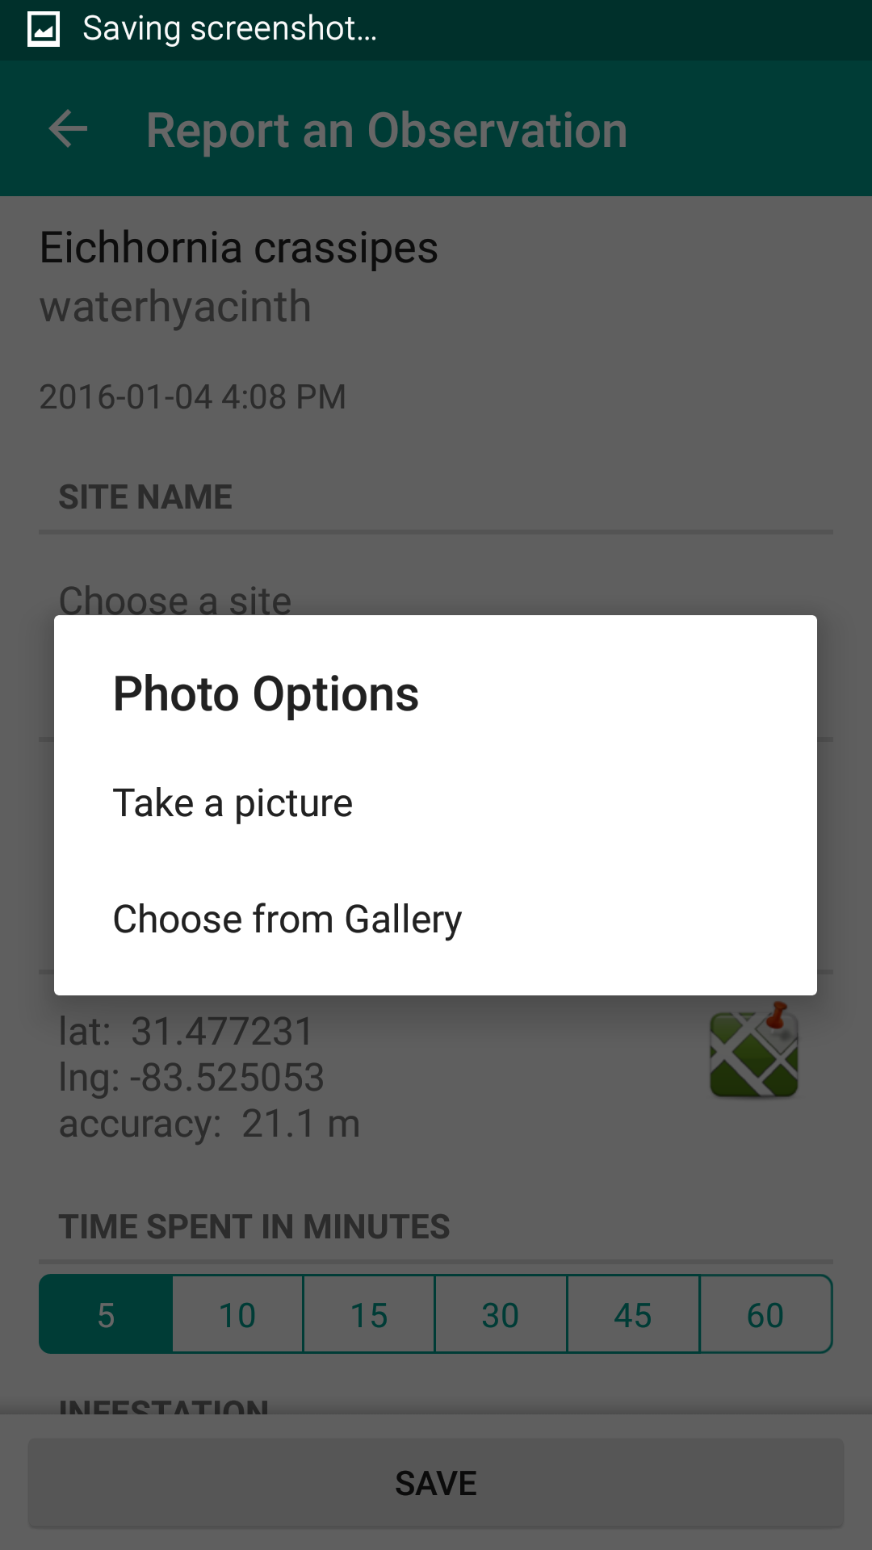

Slide 29
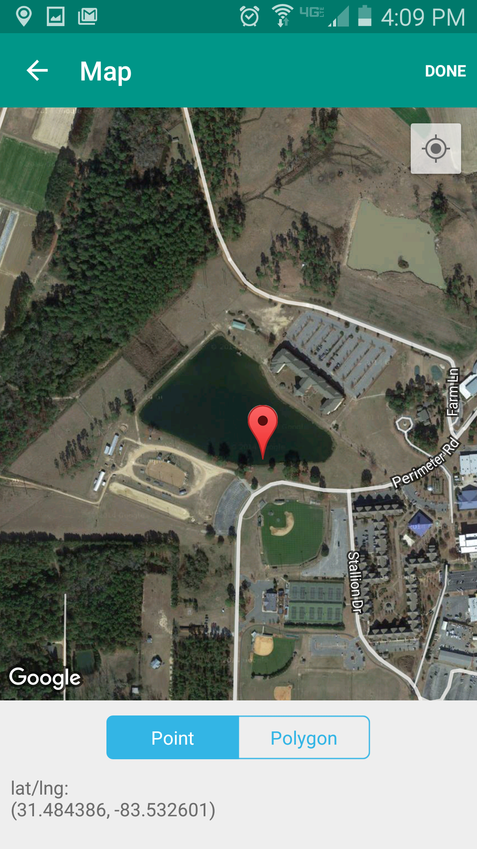
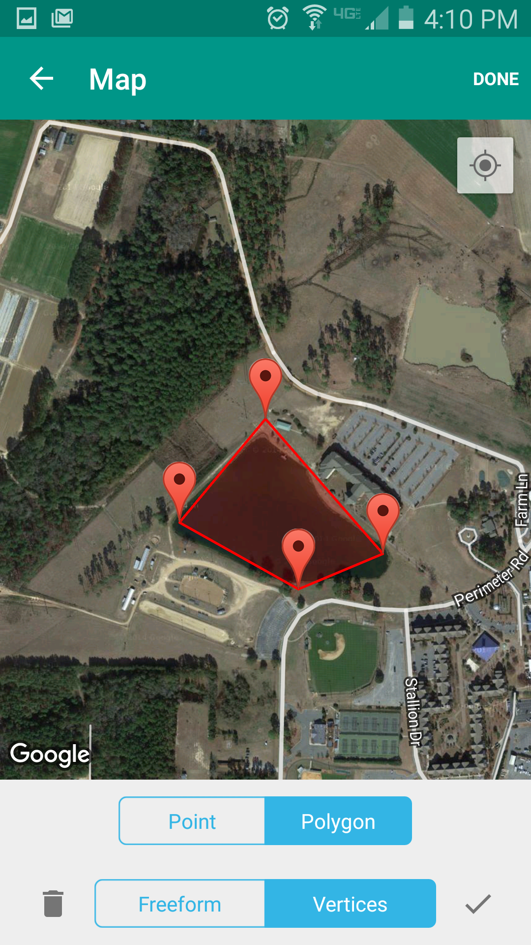

Slide 30
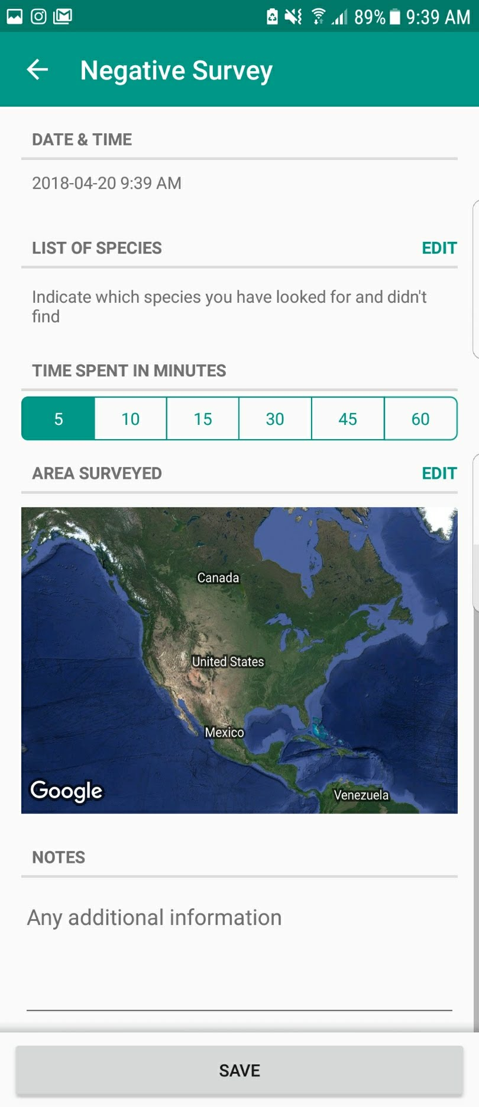
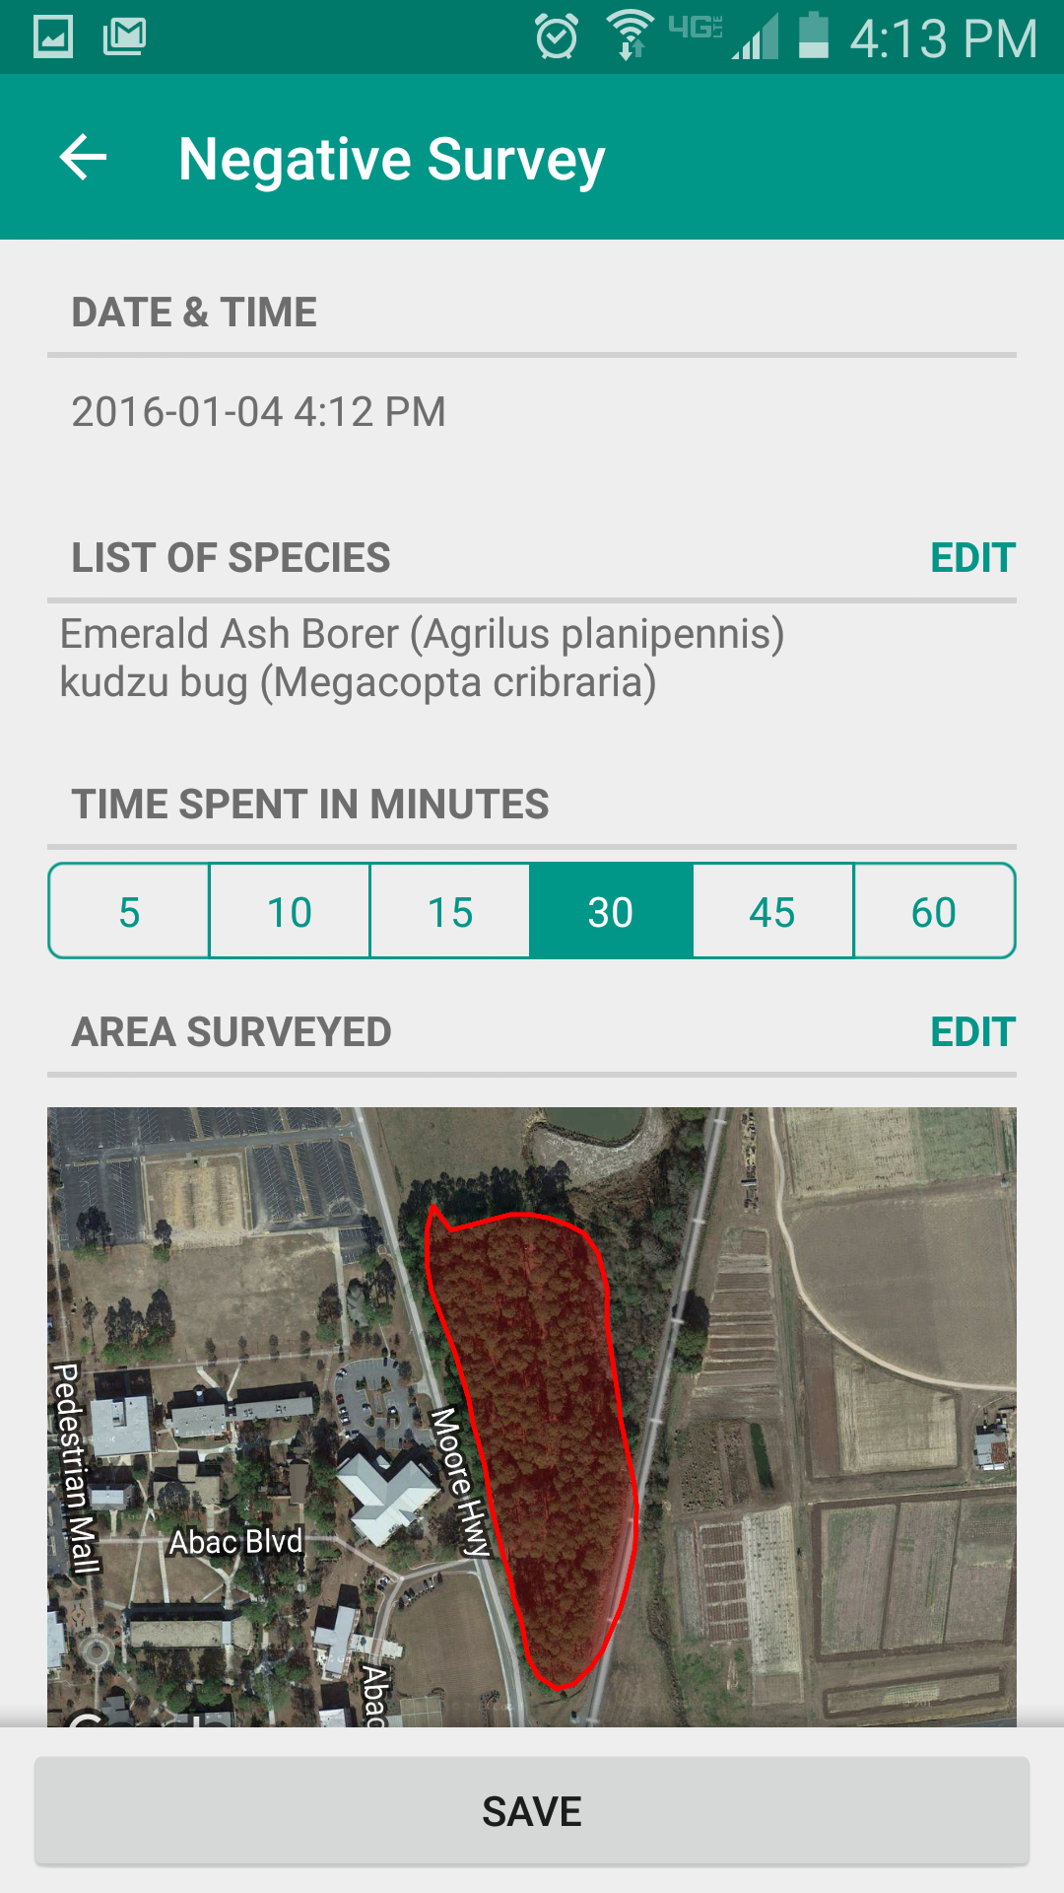

Slide 31
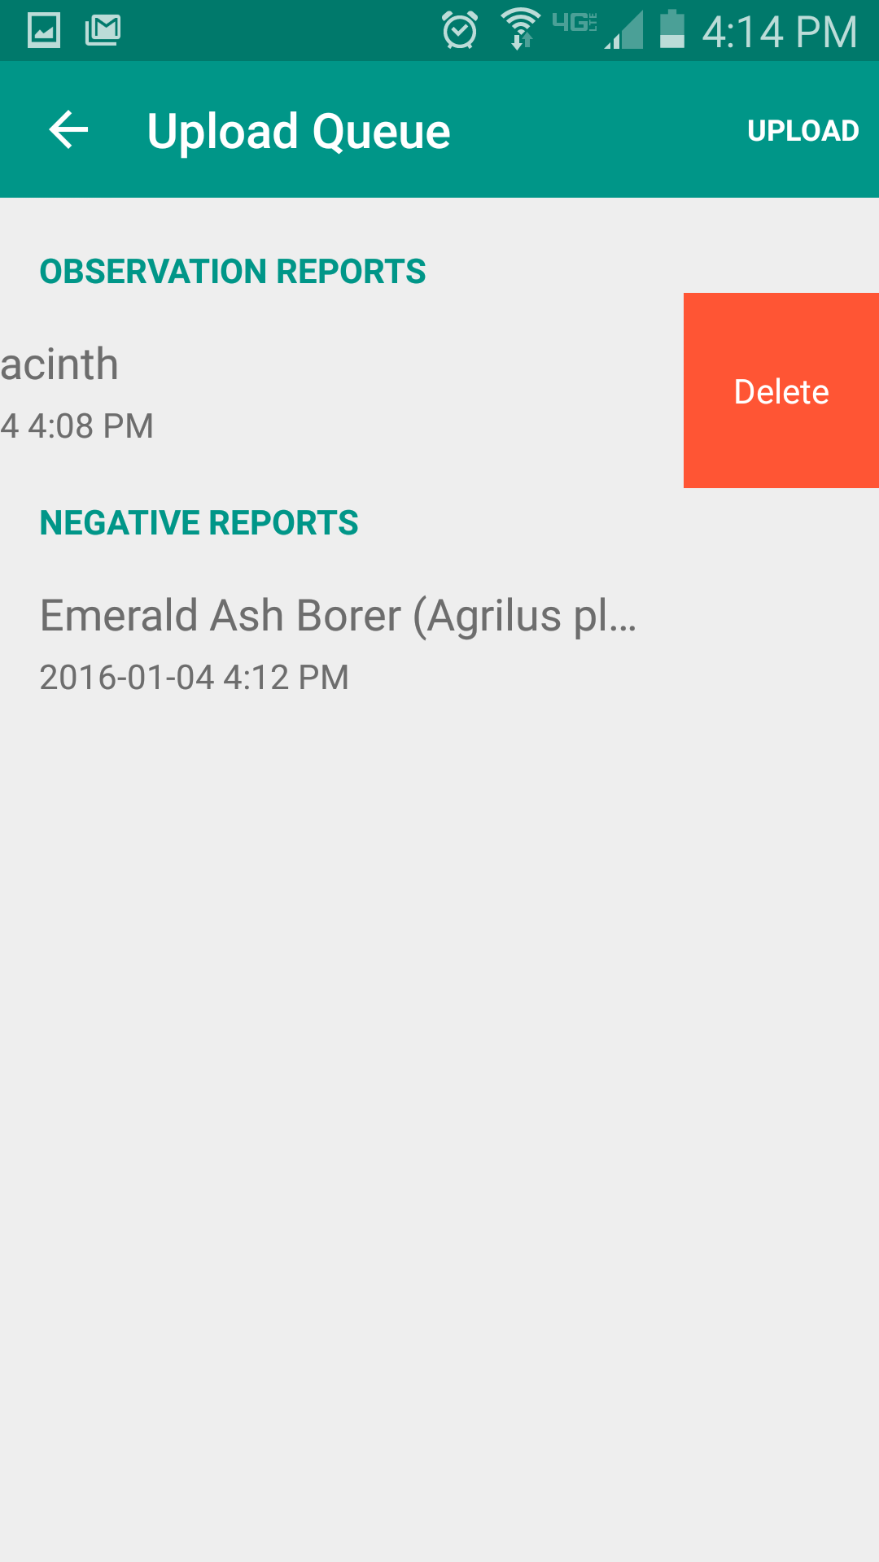
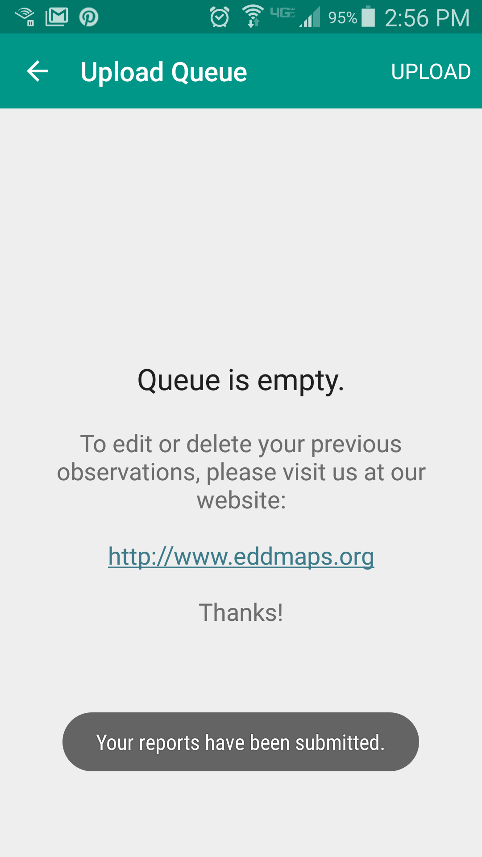

Slide 32
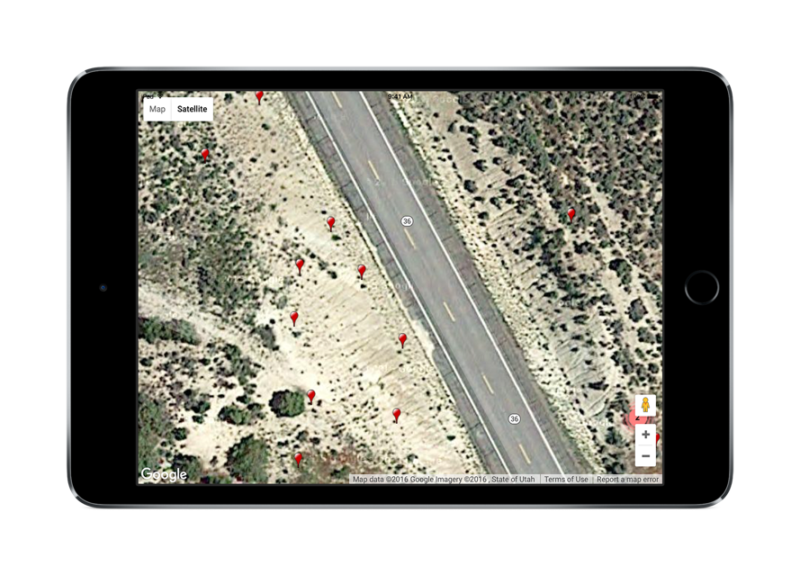
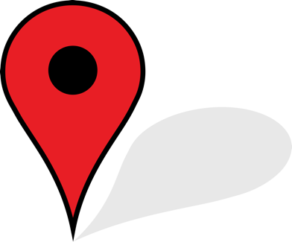

Slide 33
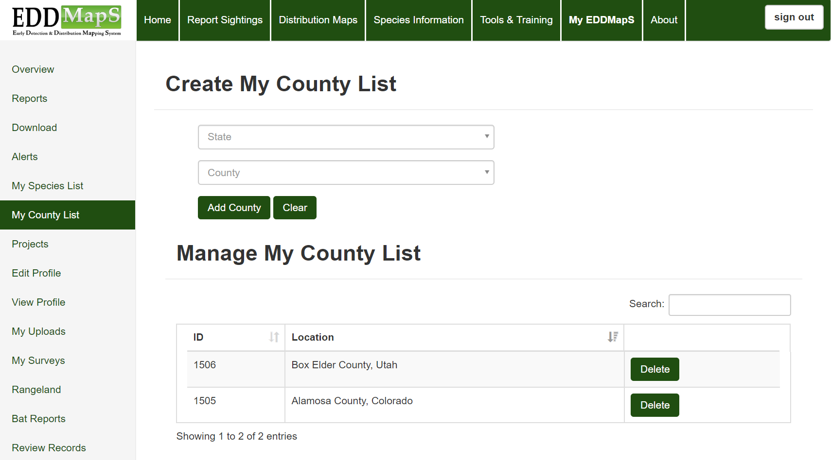
Select area on web - County

Slide 34
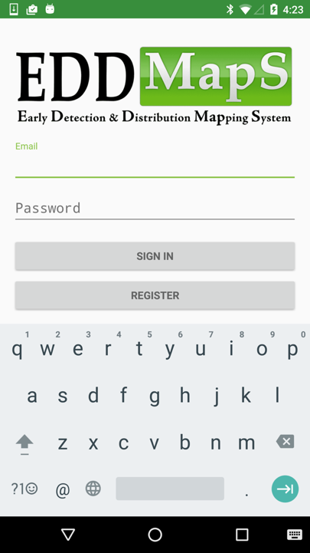
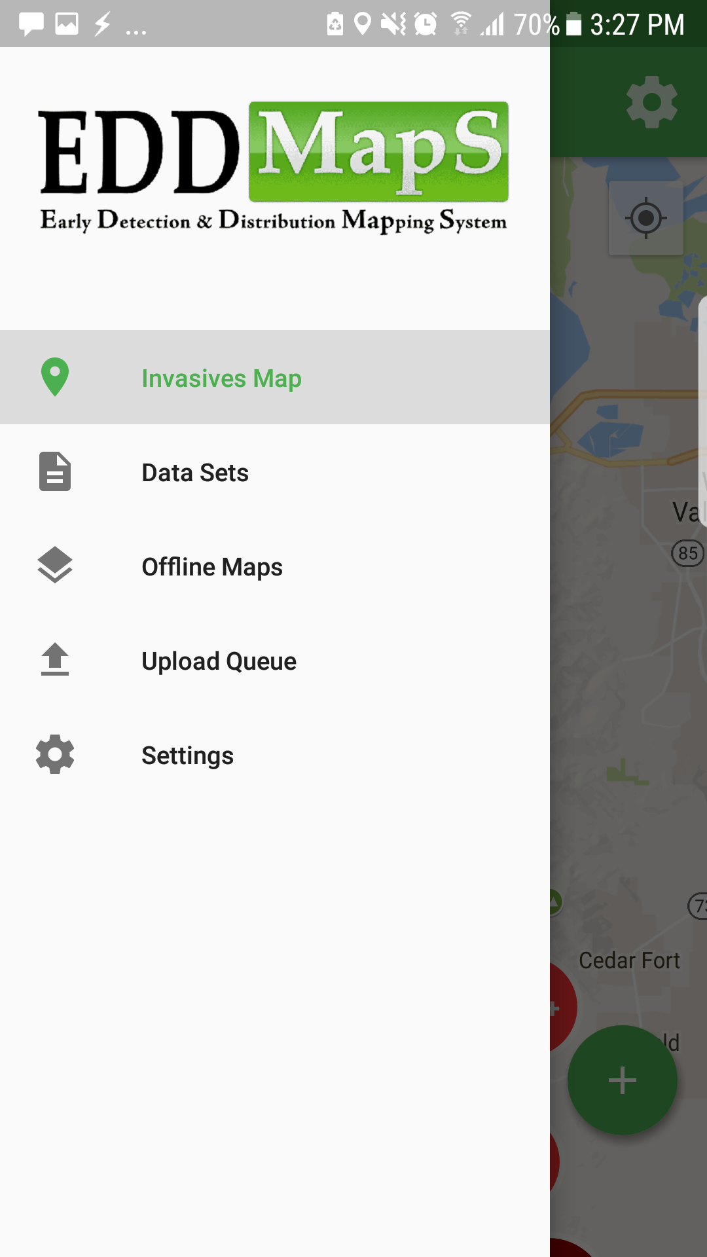

Slide 35
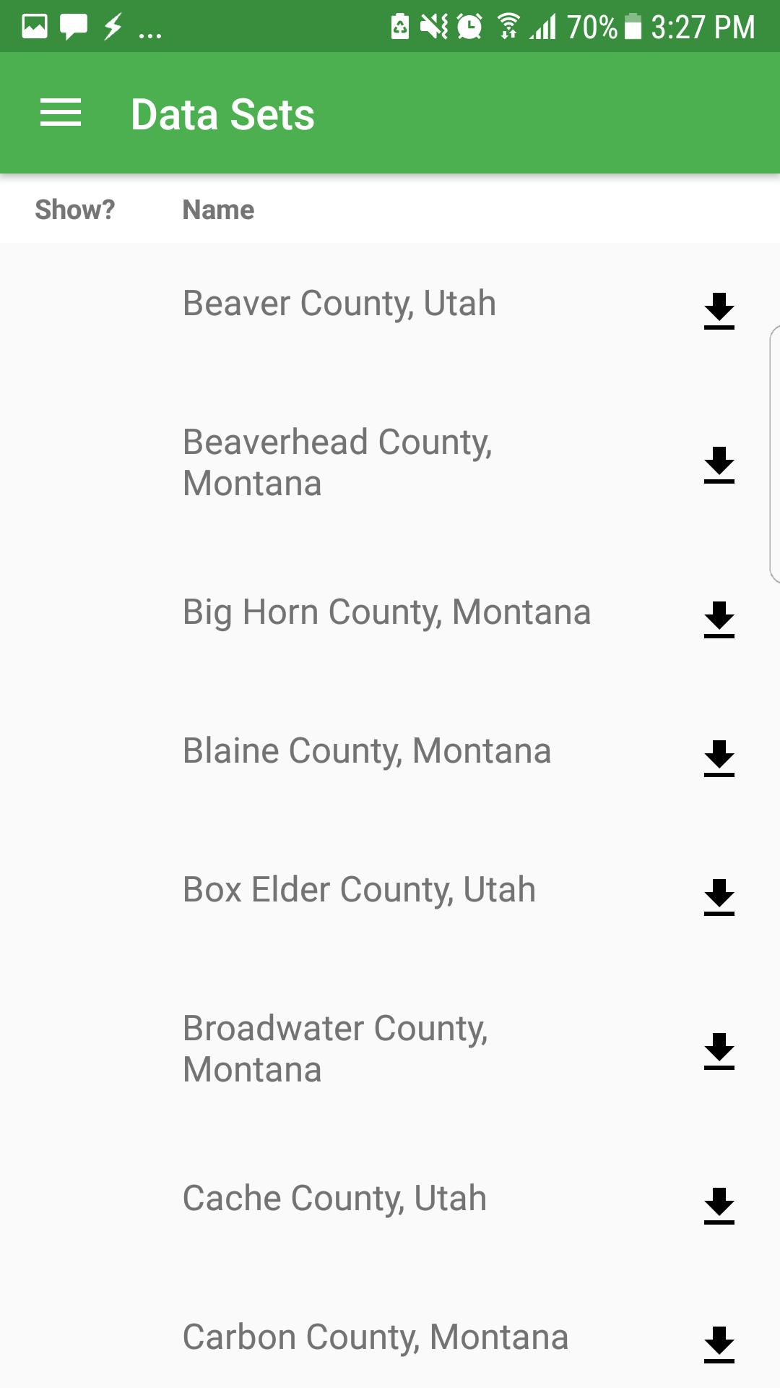
Download selected data in EDDMapS Pro

Slide 36
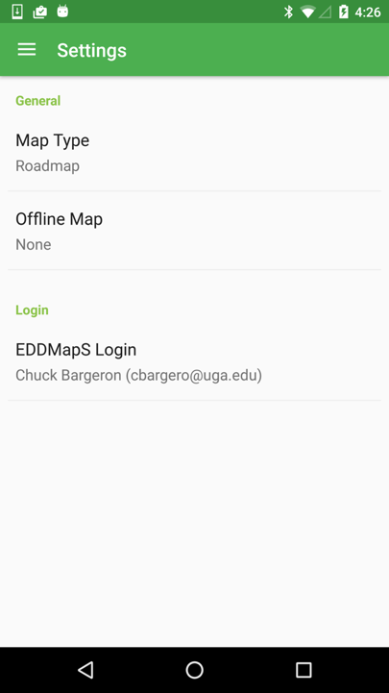

Slide 37
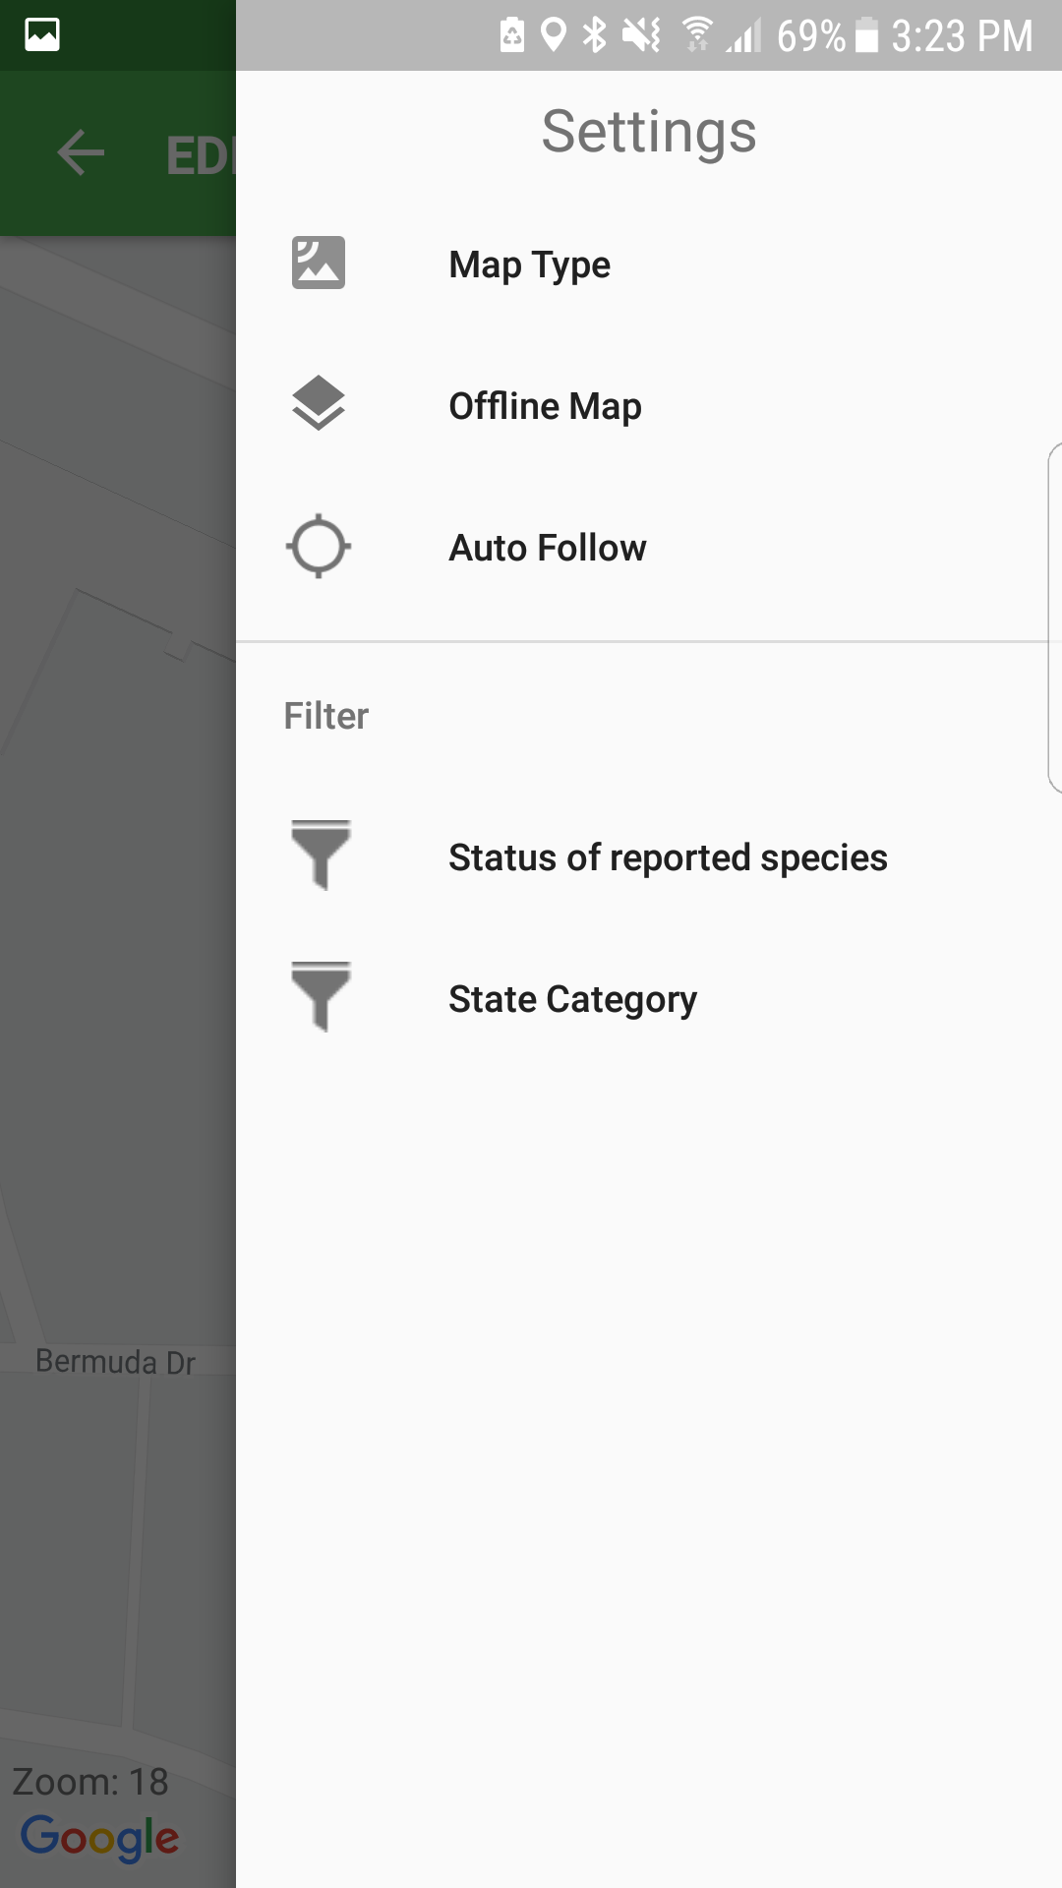
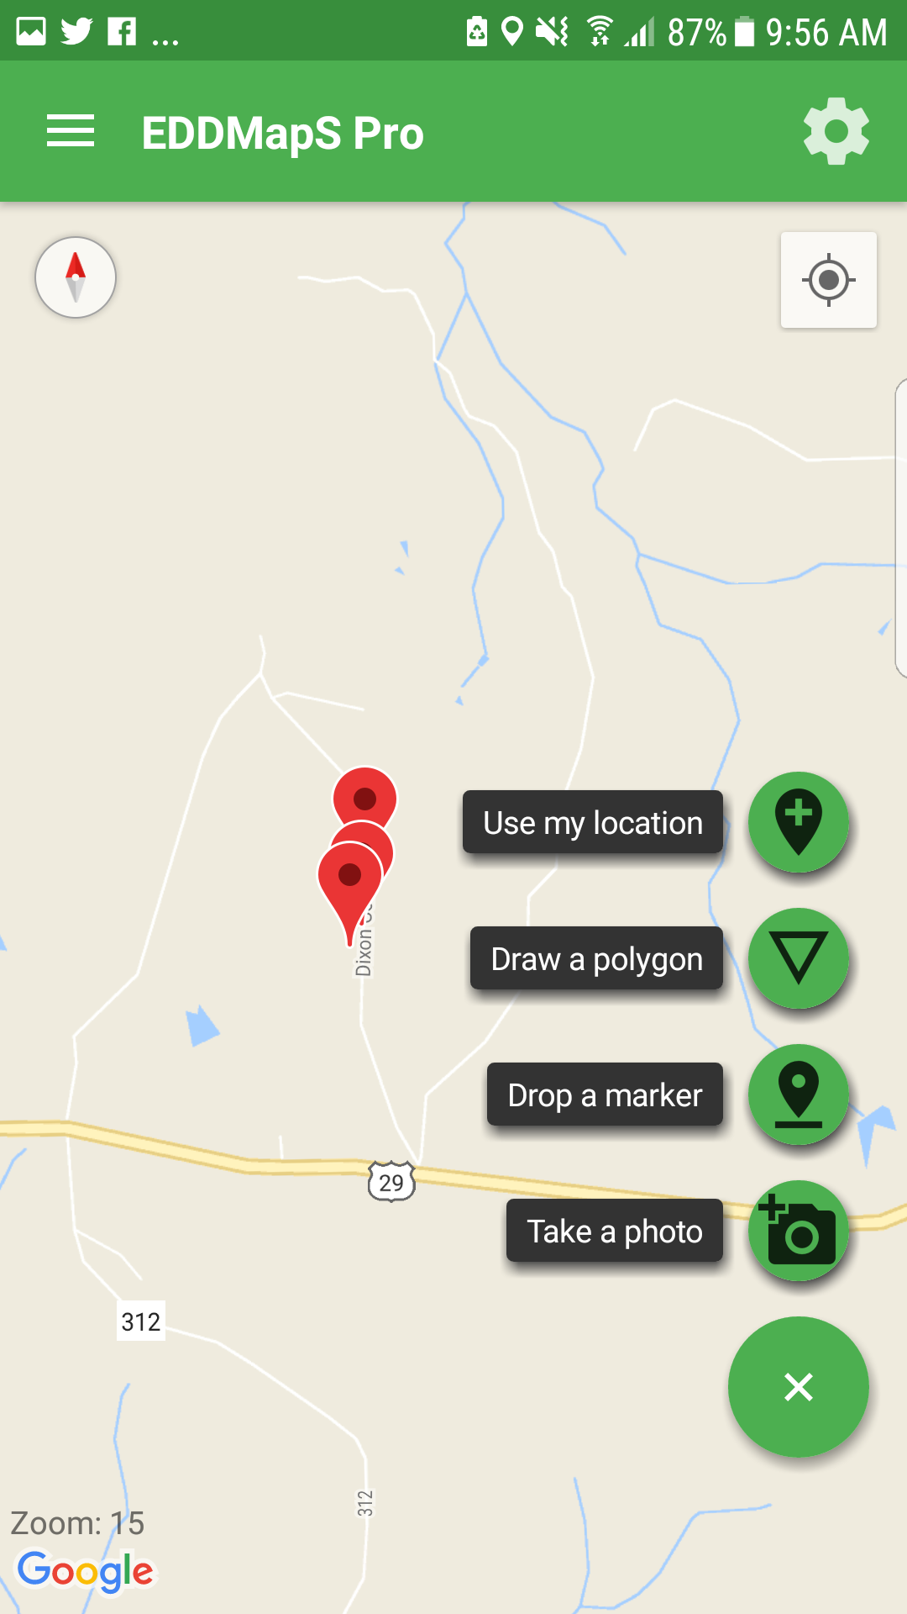

Slide 38
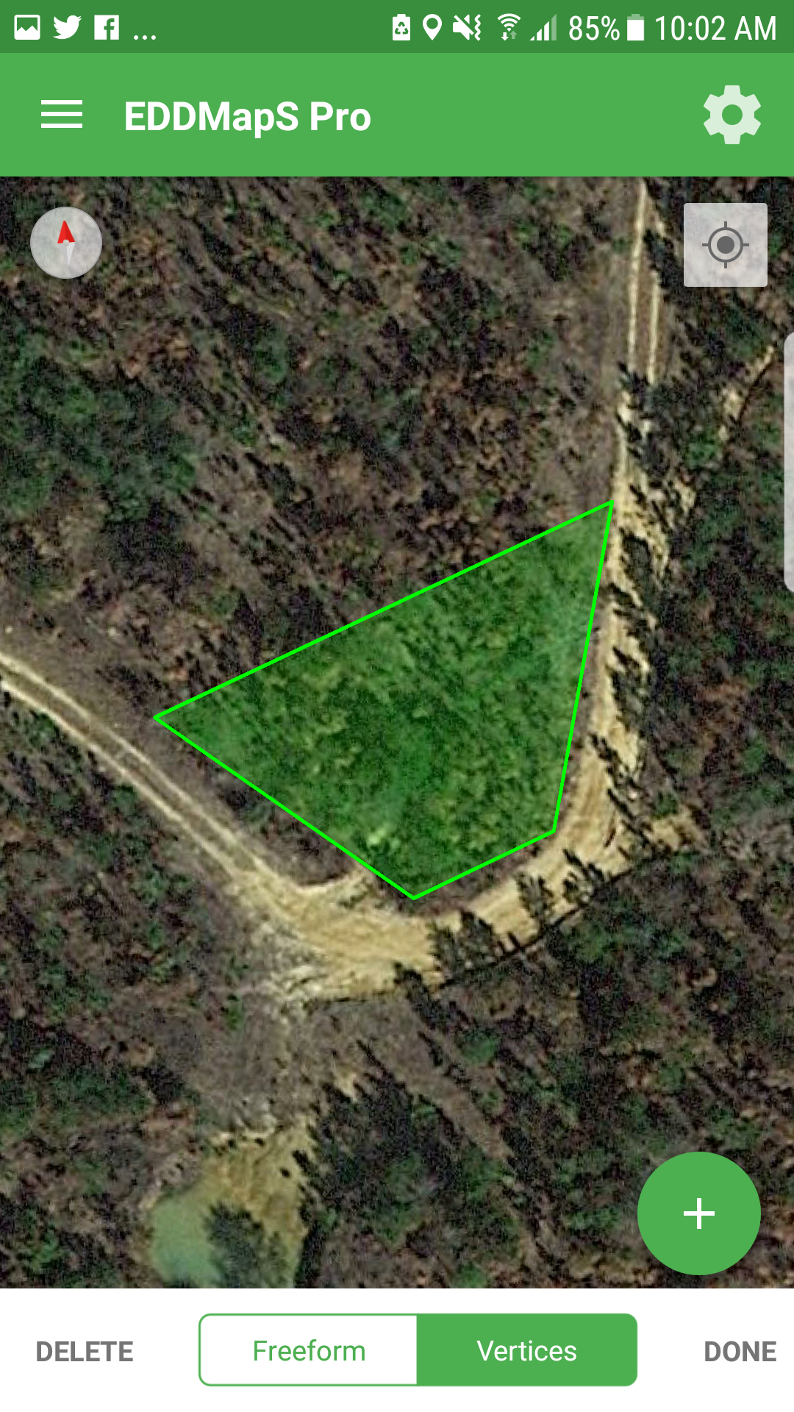
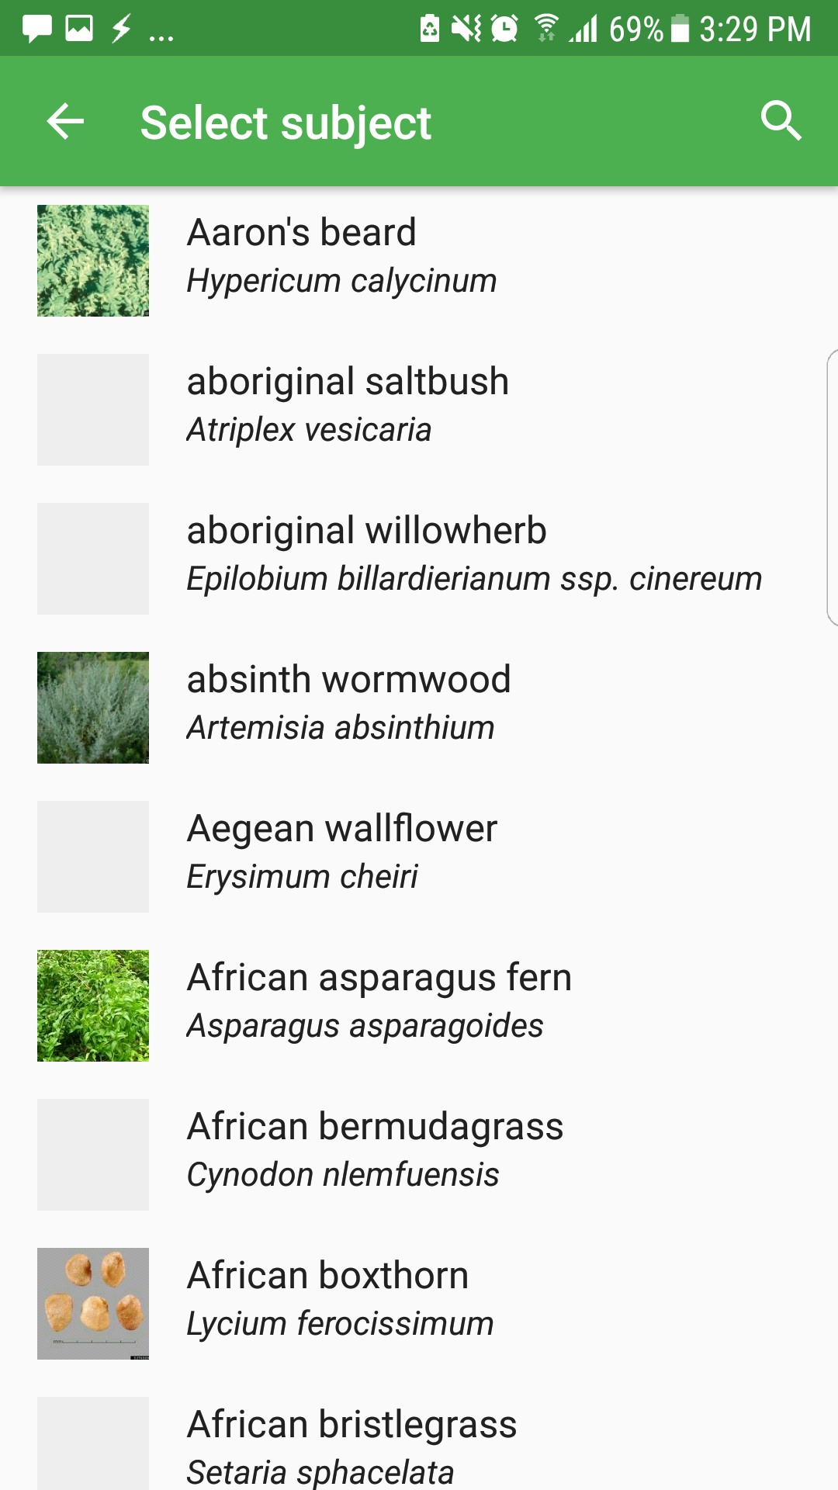
iOS does not have Freeform option

Slide 39
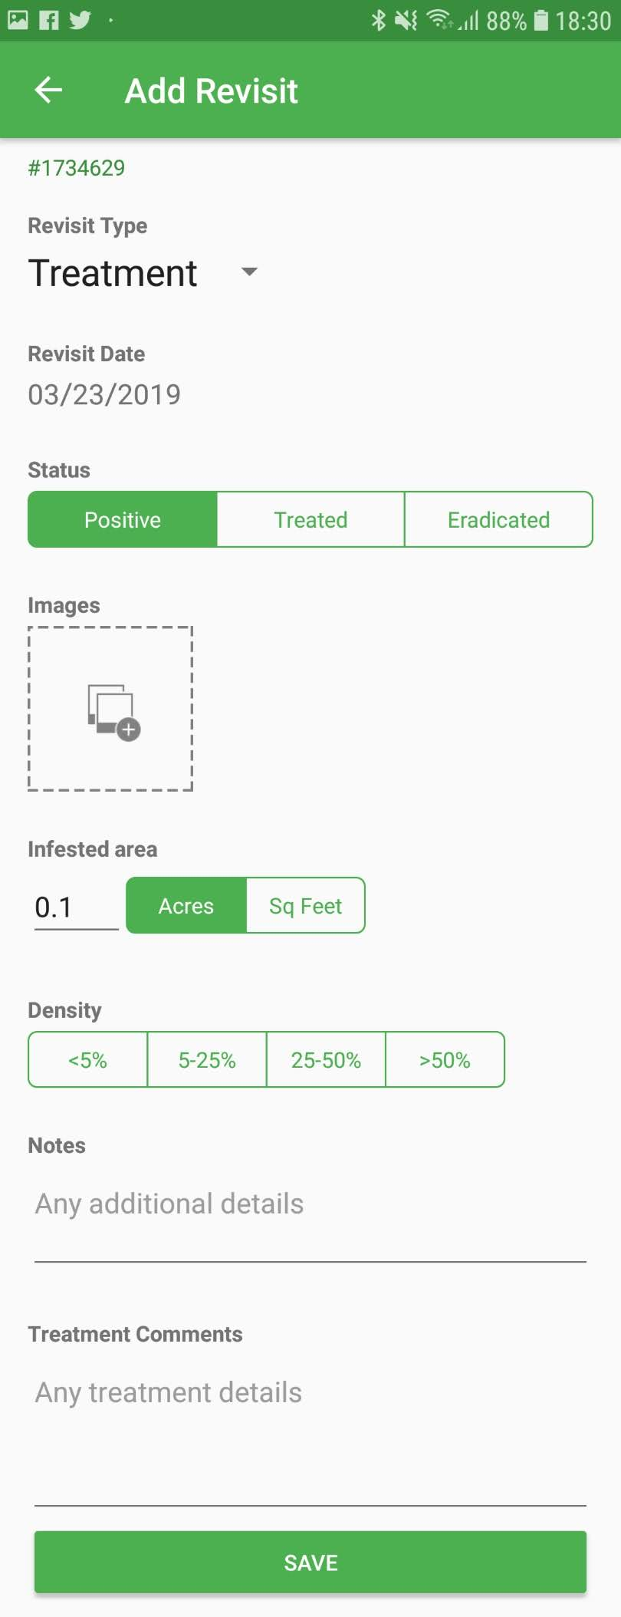

Slide 40
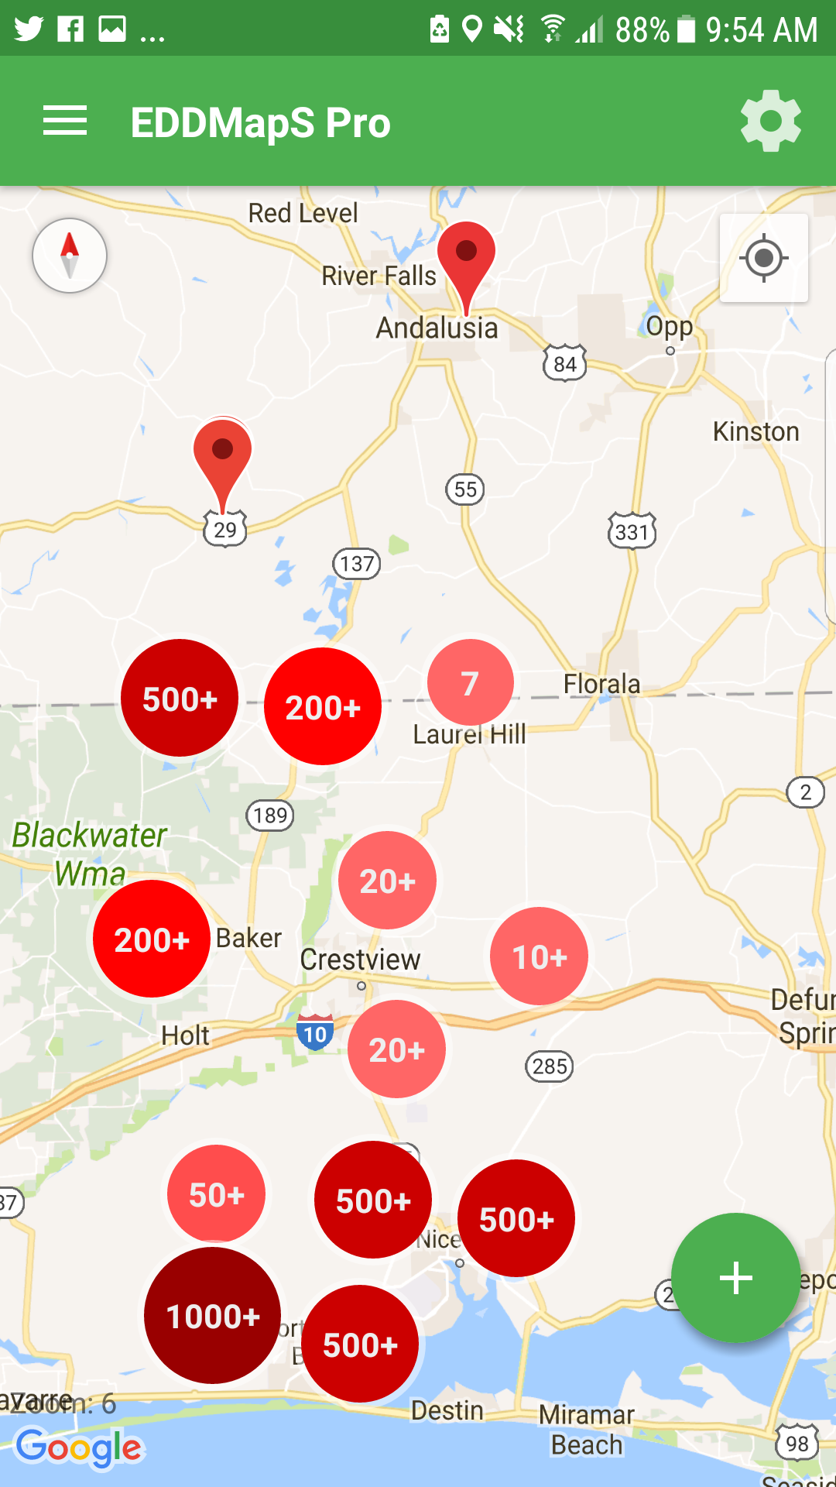
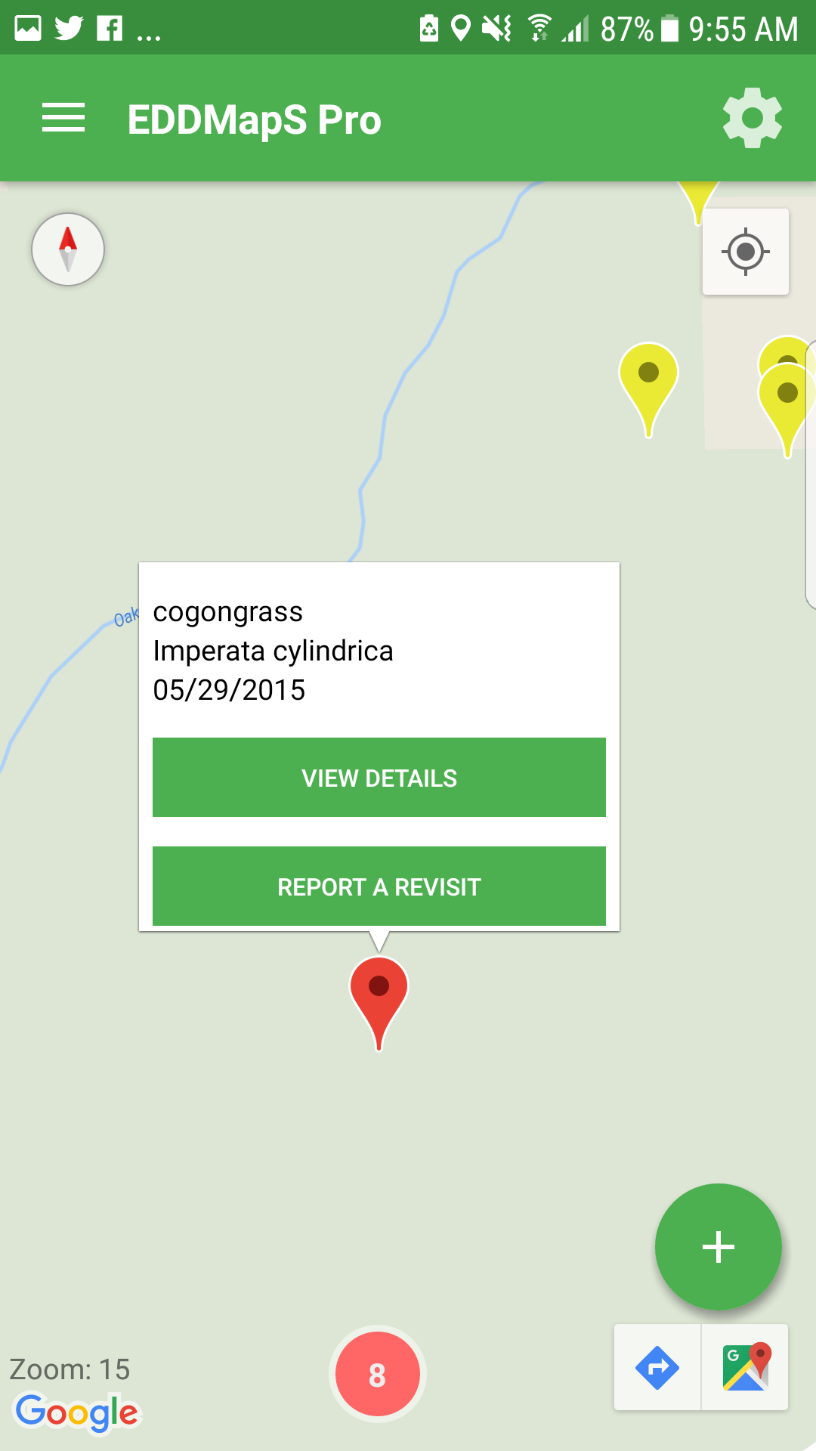

Slide 41
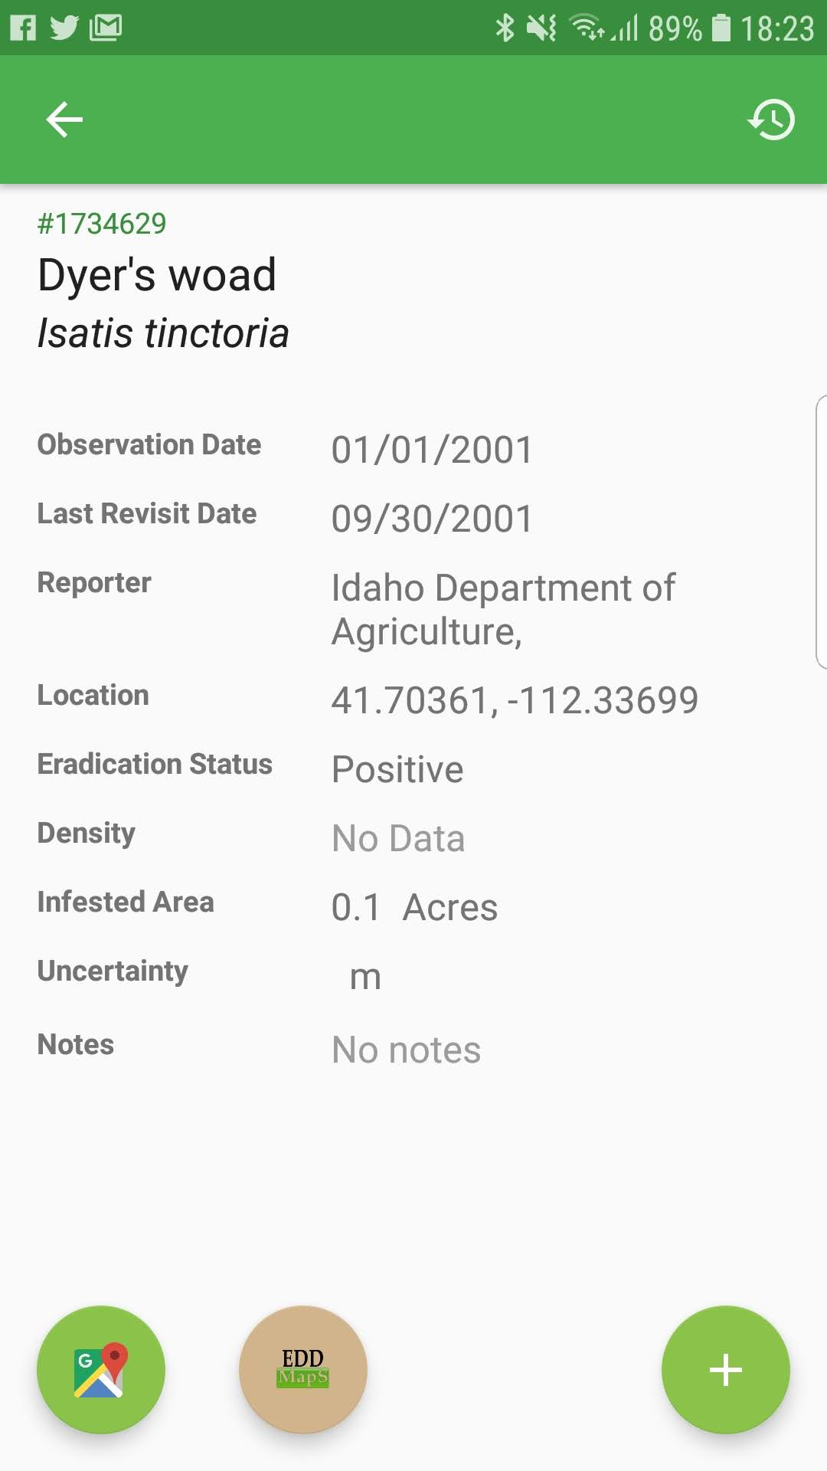
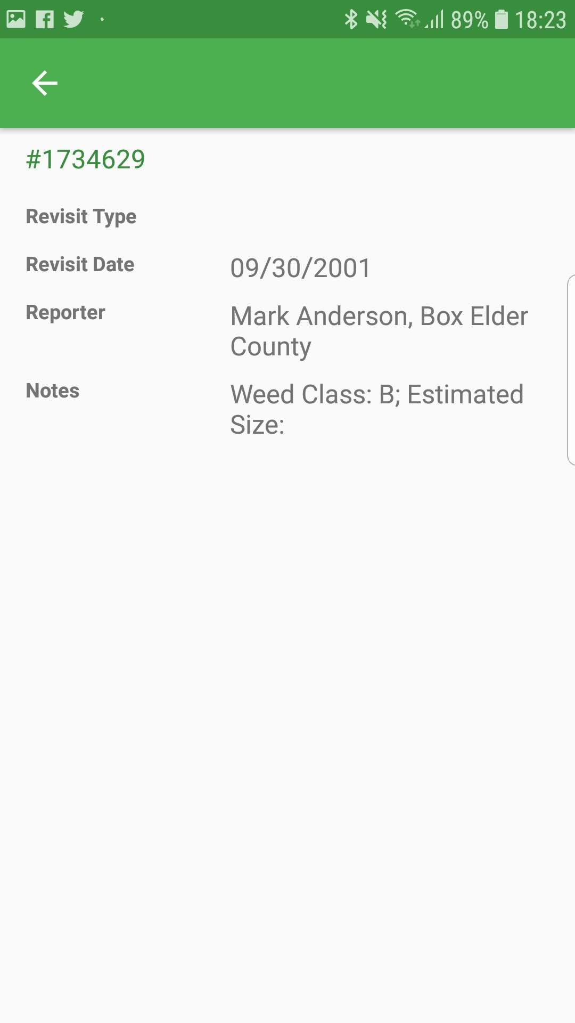

Slide 42
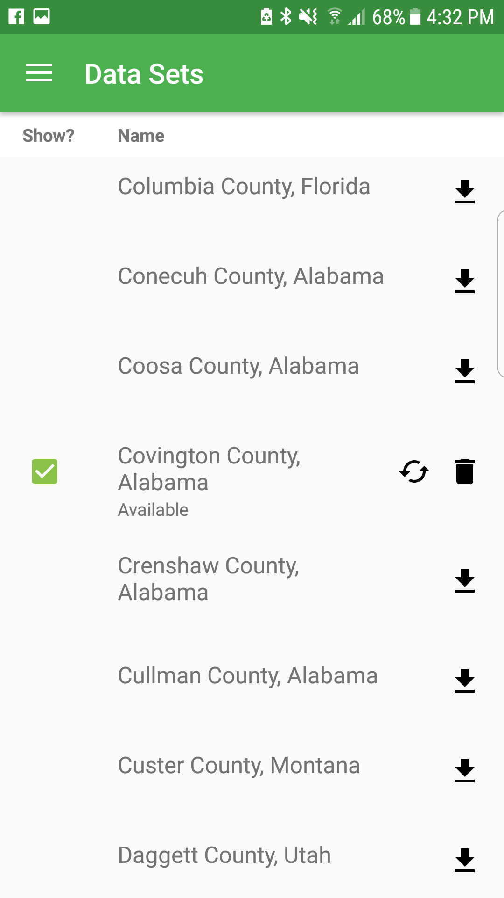
Refresh/Sync data set on phone

Slide 43
Is EDDMapS Pro being used?
Downloads – 9,045
iOS – 7,778
Android – 1,267
States – 19
Original Reports – 2,746
Revisits – 3,809

Slide 44
Observations + Revisits Sent to EDDMapS By Year
714
15
329
34
1086
1862
867
1324
629

Slide 45
Which App is best for my program?
Individual’s Responsibility for Site
Citizen Scientists
Novice
Short Term
Has Mobile Signal
SEEDN
Primary User Audience
Identification Skills
Cell Reception
App Recommendation
Professional
Expert
Long Term
No/Low Mobile Signal
EDDMapS Pro

Slide 46
Acknowledgements

Slide 47
Thanks!
Rebekah Wallace
EDDMapS Data Coordinator
Center for Invasive Species & Ecosystem Health
University of Georgia
www.eddmaps.org apps.bugwood.org www.bugwood.org

