Slide 1
Changes and innovations in the Invasive Species Market
Jim Bean Strategic Accounts Manager BASF Professional and Specialty Solutions
March 27, 2019

Slide 2
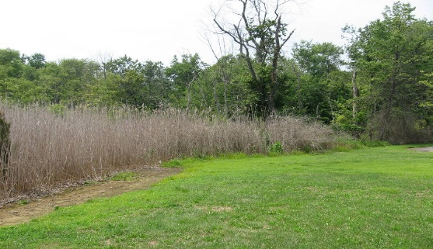
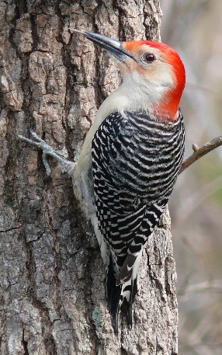
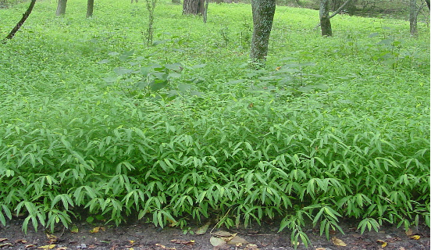
Habitat Enhancement Projects
Control invasive weeds to improve habitat
Chesapeake Bay
  Phragmites, VA, MD, DE
Red Cockaded Woodpecker Habitat Enhancement
  Fort Bragg, NC
Japanese stiltgrass control
  Great Smokey Mts and Shenandoah, NP

Slide 3
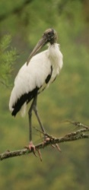
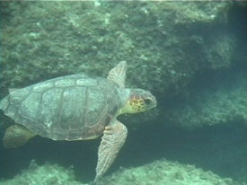
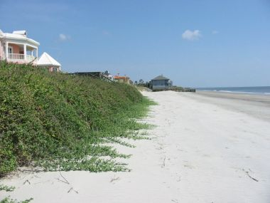
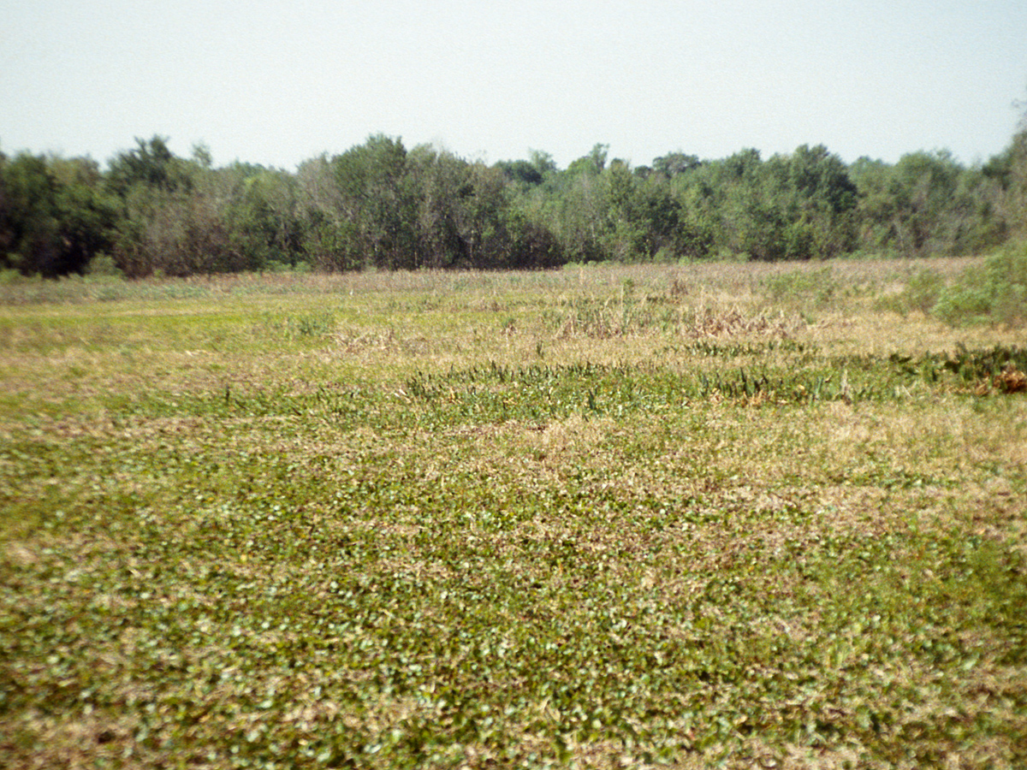
Habitat Enhancement Projects
Control invasive weeds to improve habitat
Wood Storks
  Frog’s bit control, SC
Loggerhead sea turtles
  Beach vitex control, GA,SC,NC

Slide 4
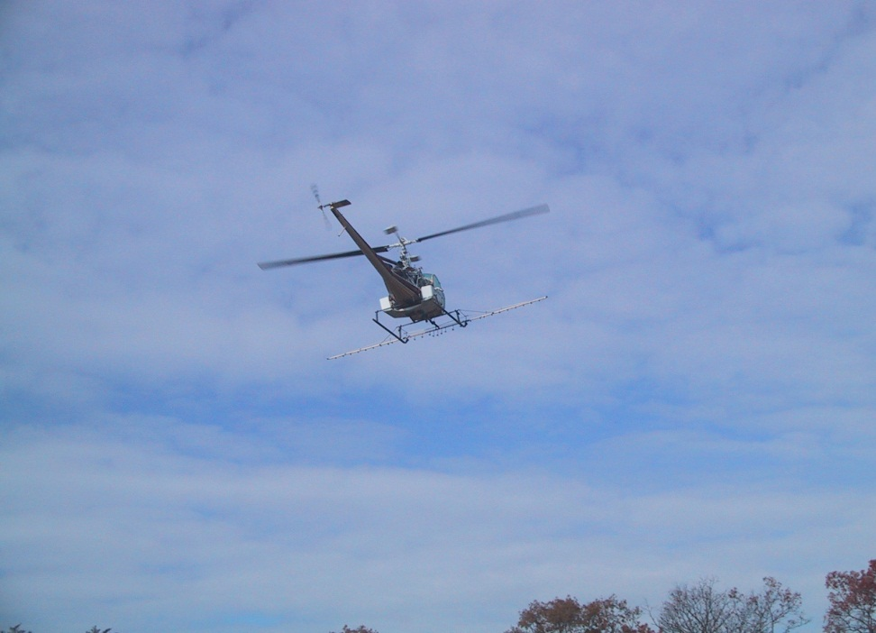
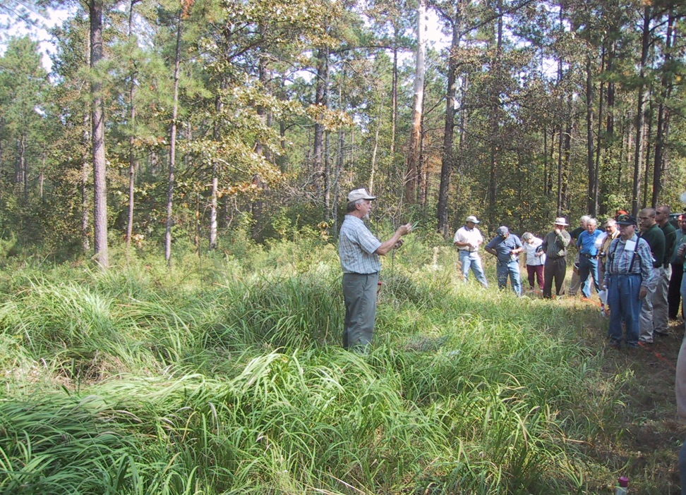
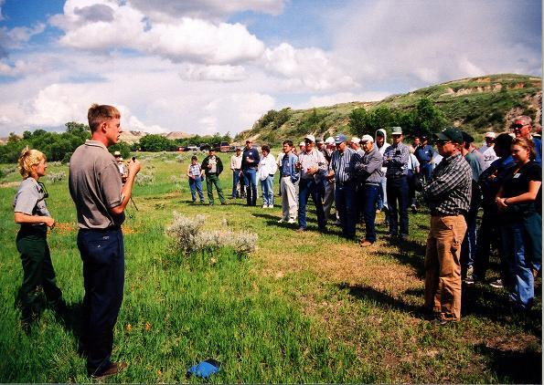
Education
Application Demos
Tours
Field Training

Slide 5
Vegetation Management Principals
Restore and improve plant, animal and human habitats
Strive to always make a positive environmental change
Protect the habitat of threatened and endangered species
Apply herbicide responsibly, using the appropriate products, amounts and application technique to achieve the desired results

Slide 6
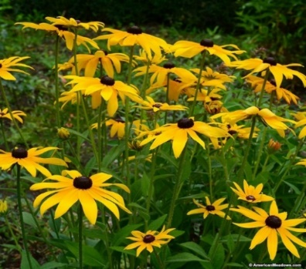
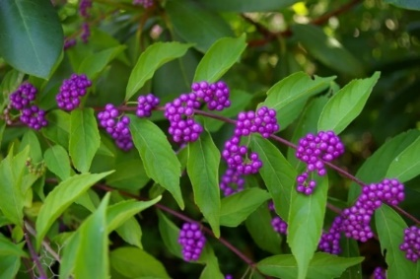
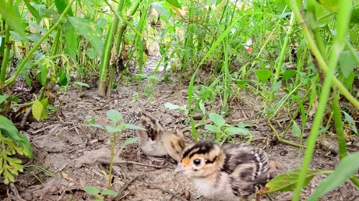
Wildlife Friendly Habitat
Early Successional Habitat
Release forbs (flowering plants)
  Increase in pollinators
Release legumes
  Nitrogen fixers
Increase high quality food
  Beautyberry
  Rubus
Provide Cover
  Release warm season grasses

Slide 7
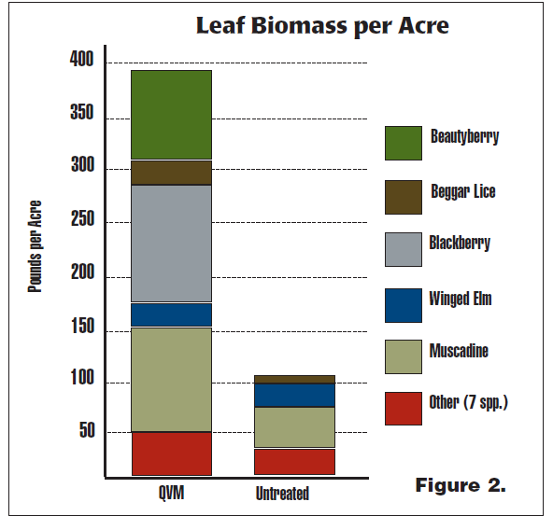
Wildlife Friendly Habitat
Early Successional Habitat
Leaf biomass
  350% increase
Digestible protein
  500 % increase
Plant diversity
  QVM
    99 species
  Untreated
    38 species
Result in a high quality diet

Slide 8

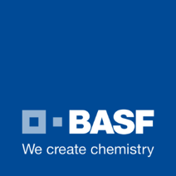
The BASF Purpose
We create chemistry for a sustainable future.
We combine economic success, social responsibility and environmental protection. Through science and innovation we enable our customers to meet the current and future needs of society. We see three
major areas in which innovations based on our chemistry will play a key role:
Resources, environment and climate
Food and nutrition
Quality of life
Notes:
In 2050, more than 9 billion people will live on our planet. The world population and its demands will keep growing, while the planet’s resources are finite. If nothing changes, we will need the resources of almost 3 of our planets to meet the demands of the population. This will pose huge global challenges.
Another example: Our world will need to produce more food from now to 2050 than we have produced so far since the history of mankind.
We see 3 major areas in which innovations based on our chemistry will play a key role.
Resources, environment and climate
Food and nutrition
Quality of life
BASF innovations are developed and evaluated for sustainability by combining the economic success, social responsibility, and environmental protection factors. All 3 factors are a requirement of sustainability.

Slide 9

Connecting Innovation and Sustainability
Sustainable development is about balancing
the needs of society in three areas:
Economic
Environmental
Social
All new products developed by BASF
have stringent sustainability requirements that
support our BASF Purpose:
We create chemistry for a sustainable future
Notes:
Our innovation business approach is centered around customer needs. Proper stewardship of our innovations allows BASF to create chemistry for a sustainable future. Each new innovation must pass Economic, Environmental, and Social sustainability criteria before advancement through our development process. In this regard, innovation and sustainability are inter-connected.

Slide 10
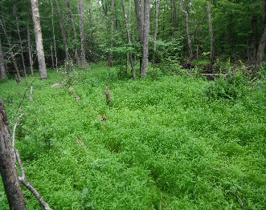
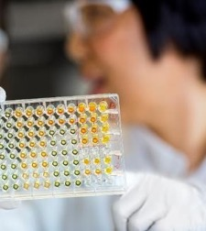

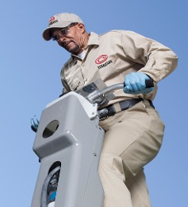
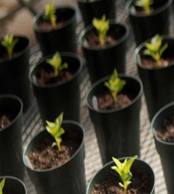
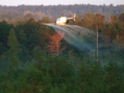
BASF Professional and Specialty Solutions
Ambitious growth plan to fulfill your needs
How we contribute to a sustainable future
Sustainability
Contributions
Turf
Pest Control
Ornamentals
Pro VM
  Mitigate risk to non-target organisms
  Consume less resources
  Reduce contamination & protect food quality
  Prevention of the spread of disease
  Renewable resource production
  Intrinsic® Brand Fungicides
  Lexicon® Intrinsic®
  Xzemplar® Intrinsic®
  Plant Health benefits
  Living Acres Expansion
  Termidor® HE
  Termidor® HP
  Trelona®
  Selontra®
  Fendona®
  Sultan®
  Nemasys®
  Empress® Plus
  Ventigra®
  VeliferTM
  Detail®
  Frequency®
  Plateau®
  Invasive Weed Control
  Wildlife and habitat improvement
Notes:
Additional information on slide examples:
Intrinsic Brand Fungicides provide disease control and plant health benefits. Treated plants have been shown to be stronger and more efficient, especially when stressed (such as heat, drought, cold, and more).
Living Acres is a pollinator awareness and stewardship project that was expanded from our Crop colleagues into the golf turf market. This project provides habitat for the Monarch Butterfly to promote species reproduction.
Termidor HE and HP reduce the amount of product needed to protect a structure from termites, while using less water and requiring less time to treat a structure.
Trelona is a baiting system that very attractive to termites, allowing them to transfer the bait to their nestmates for efficient control. Quick to install and service.
Selontra rodent bait control rodents with less consumption (due to stop-feed action).
Fendona encapsulated insecticide controls mosquitos (which are known to vector diseases).
Sultan miticide controls spider mites and can be used in conjunction with a beneficial mite program in ornamentals.
Ventigra insecticide is soft on beneficial insects and pollinators, promoting IPM
Velifer provides biological activity on whitefly in greenhouse ornamental crops.
Detail helps glyphosate burn down weeds faster with less product applied.
Plateau and Frequency provide long-term control of weeds in support of professional vegetation management, which in turn reduces power outages and promotes a more reliable power supply.
Chemical control of weeds around solar panel grids allow for lower weed control costs than mowing, and easier access to the panels for inspection or maintenance.
Control of undesirable weeds can allow for the germination and release of desirable plants in wooded areas that provides a habitat that will attract and support wildlife.

Slide 11
R&D Expenditures by Industry Segment
BASF invests more money in research and development for Agricultural Solutions than any other industry segment
11%
Chemicals
Corporate Research, Other
21%
20%
2%
$2.3
million / day
Performance Products
Oil & Gas
26%
20%
Agricultural Solutions
Functional Materials & Solutions
Notes:
1,953 million euros transposed to $2,285 million (at 1.17 exchange rate) investment in R&D.
BASF invest more money (26%) in R&D for Agricultural Solutions than any other industry segment.
$2,285 M x 26% = $594 M per year in Agricultural Solutions
$594 M divided into 52 weeks = $11.4 M per week in Agricultural Solutions
$11.4 M divided into a 5 day work week = $2.28 M per day investment in Agricultural Solutions

Slide 12
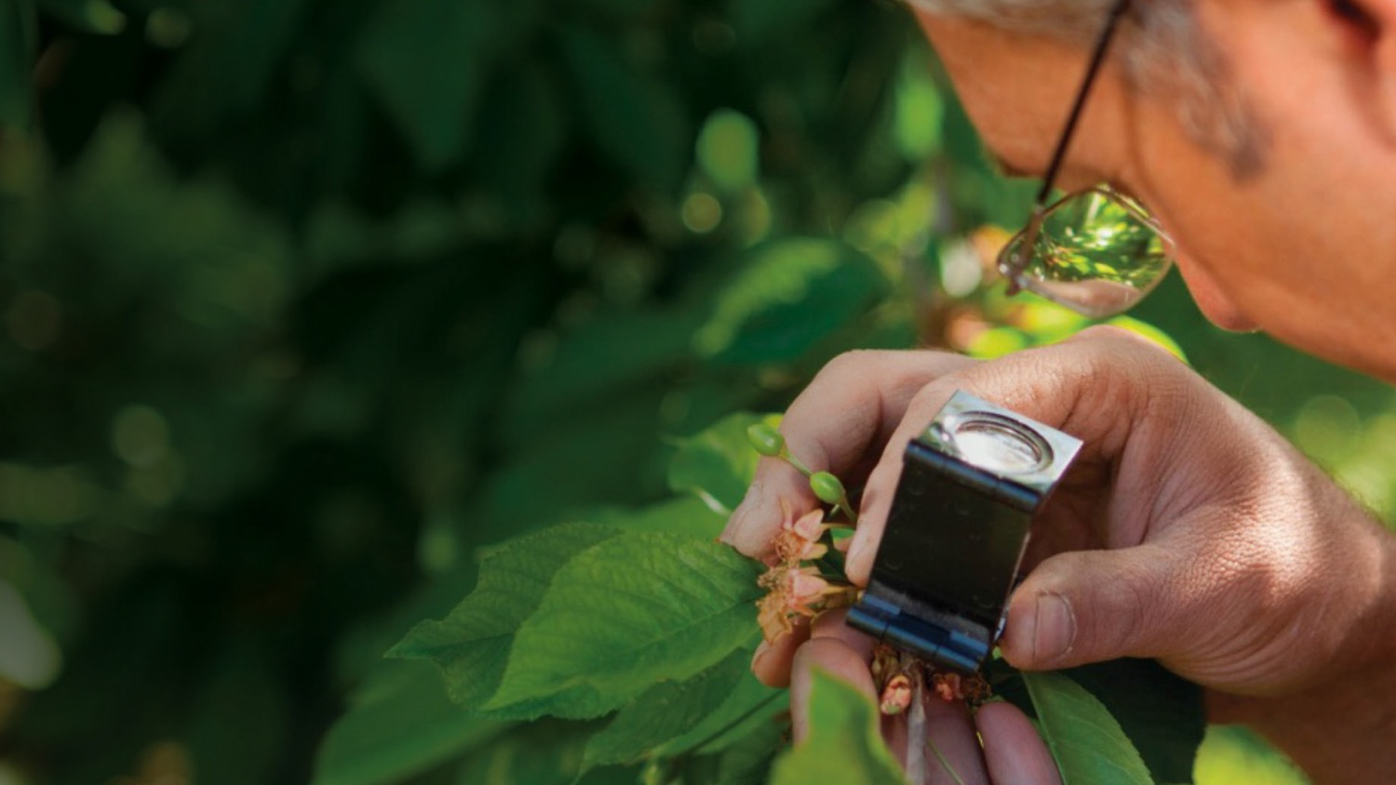
BASF Innovation Facts and Figures 2016
10,700 employees worldwide dedicated to research and development
3,000 research projects
Partnerships with more than 600 universities, research institutes, industry partners and high-tech joint ventures
Ranked #1 in Patent Asset Index™
  1000 new patents filed in 2015
  850 new patents filed in 2016
Ranked 20th Most Innovative Company in the World*
More than € 9 billion in sales with products, processes and solutions that have been on the market within the last ﬁve years
Note: Facts and figures cover all BASF operating divisions, including Agricultural Solutions.
*Boston Consulting Group Global Innovation Survey, 2016. Released in 2017.
Notes:
Footnote: These facts and figures cover all BASF operating divisions, including Agricultural Solutions
BASF expects that our investment in R&D will result in the market success of our innovations. We partner with additional experts outside BASF when needed. Our patent activity, Most Innovative Company ranking, and our sales of new innovations confirm the success of our innovation strategy.
BASF BCG Innovation Survey ranking:
Moved up 19 spots to #29 in 2015 (report released in 2016)
Moved up 9 spots to #20 in 2016 (report released in 2017)
Other companies on the list:
#1 Apple
#2 Google
#3 Tesla Motors
#4 Microsoft
#5 Amazon
#11 Bayer
#18 DuPont
#19 Dow Chemical Company
#21 Airbnb
#22 Under Armour
#36 The Walt Disney Company
#50 Proctor & Gamble

Slide 13

Professional & Specialty Solutions has an unrivaled innovation pipeline
20 innovations by the end of 2020, focused on our customers
Innovations in multiple markets, for multiple pests
The result of $2M per day investment
Alpine® Enhancement
Fendona™ Enhancement
Trelona® Enhancement
Future Biologicals
New Herbicides
New Fungicides
New Insecticides
Fendona™ PI
Limus®
Sundec™
Termidor® HP II
Trelona® AB
Velifer™
Fendona™ CS
Pageant® TR
Segment® II
Selontra®
Serifel® M
Maxtima™ (Revysol®)
Navicon™ (Revysol®)
Terinda™
Vedira™
Empress® Plus
New Termite Offer
Ventigra™ (Inscalis™)
2017
2018
2019
2020
2021+
™: Trademark of BASF; ®: Registered trademark of BASF.
Note: Products not yet EPA registered are not offered for sale.
Notes:
BASF is a leader in innovation. We have been innovating for over 150 years. This slide highlights 20 new innovations coming to market by the end of 2020.
The innovations are listed for US P&SS T&O and URT businesses. A portion of every product sale is reinvested in more new innovations to support our customers.
Each new active ingredient is developed further into different formulations and uses to fit specific market and customer needs.
Additional innovation information:
Limus is a urease inhibitor that increases efficiency of nitrogen use
Sundec is an alpha-cypermethrin based product for the Poultry and Livestock market.
Terinda refers to termite products powered by the active ingredient broflanilide
Vedira refers to general pest control products powered by the active ingredient broflanilide

Slide 14
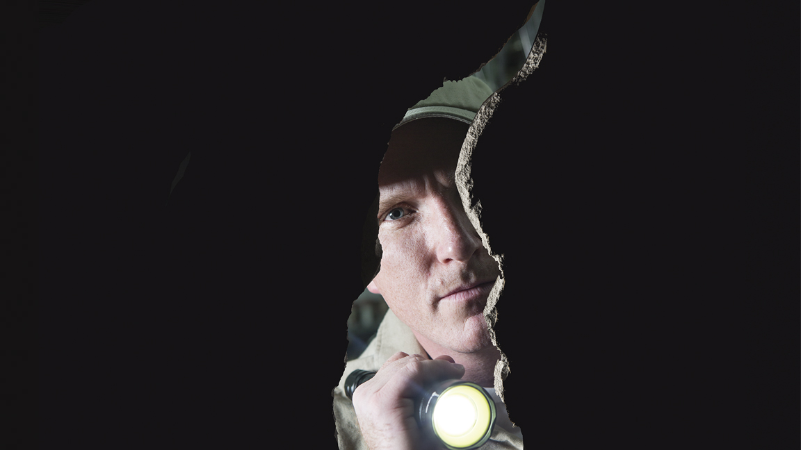
Product Discovery and Commercialization
1 in 20,000 compounds are commercialized
11 years+
$286 million+
Most new compounds are fungicides or insecticides
Notes:
Footnote: These facts and figures cover all BASF operating divisions, including Agricultural Solutions
BASF expects that our investment in R&D will result in the market success of our innovations. We partner with additional experts outside BASF when needed. Our patent activity, Most Innovative Company ranking, and our sales of new innovations confirm the success of our innovation strategy.
BASF BCG Innovation Survey ranking:
Moved up 19 spots to #29 in 2015 (report released in 2016)
Moved up 9 spots to #20 in 2016 (report released in 2017)
Other companies on the list:
#1 Apple
#2 Google
#3 Tesla Motors
#4 Microsoft
#5 Amazon
#11 Bayer
#18 DuPont
#19 Dow Chemical Company
#21 Airbnb
#22 Under Armour
#36 The Walt Disney Company
#50 Proctor & Gamble

Slide 15

Mergers and Acquisitions
Bayer - Monsanto
Dow / Dupont - Corteva
BASF - Bayer seed business and glufosinate
Adama - NuFarm
ChemChina - Syngenta

Slide 16

Industry Changes
Discontinued products
Fewer manufacturer reps
Reduced sponsorship $
Reduced herbicide research $
Less emphasis on herbicides

Slide 17

BASF ProVM Changes
Staff reduced
Distribution model
Minimal direct customer exposure
Focus on new products

Slide 18
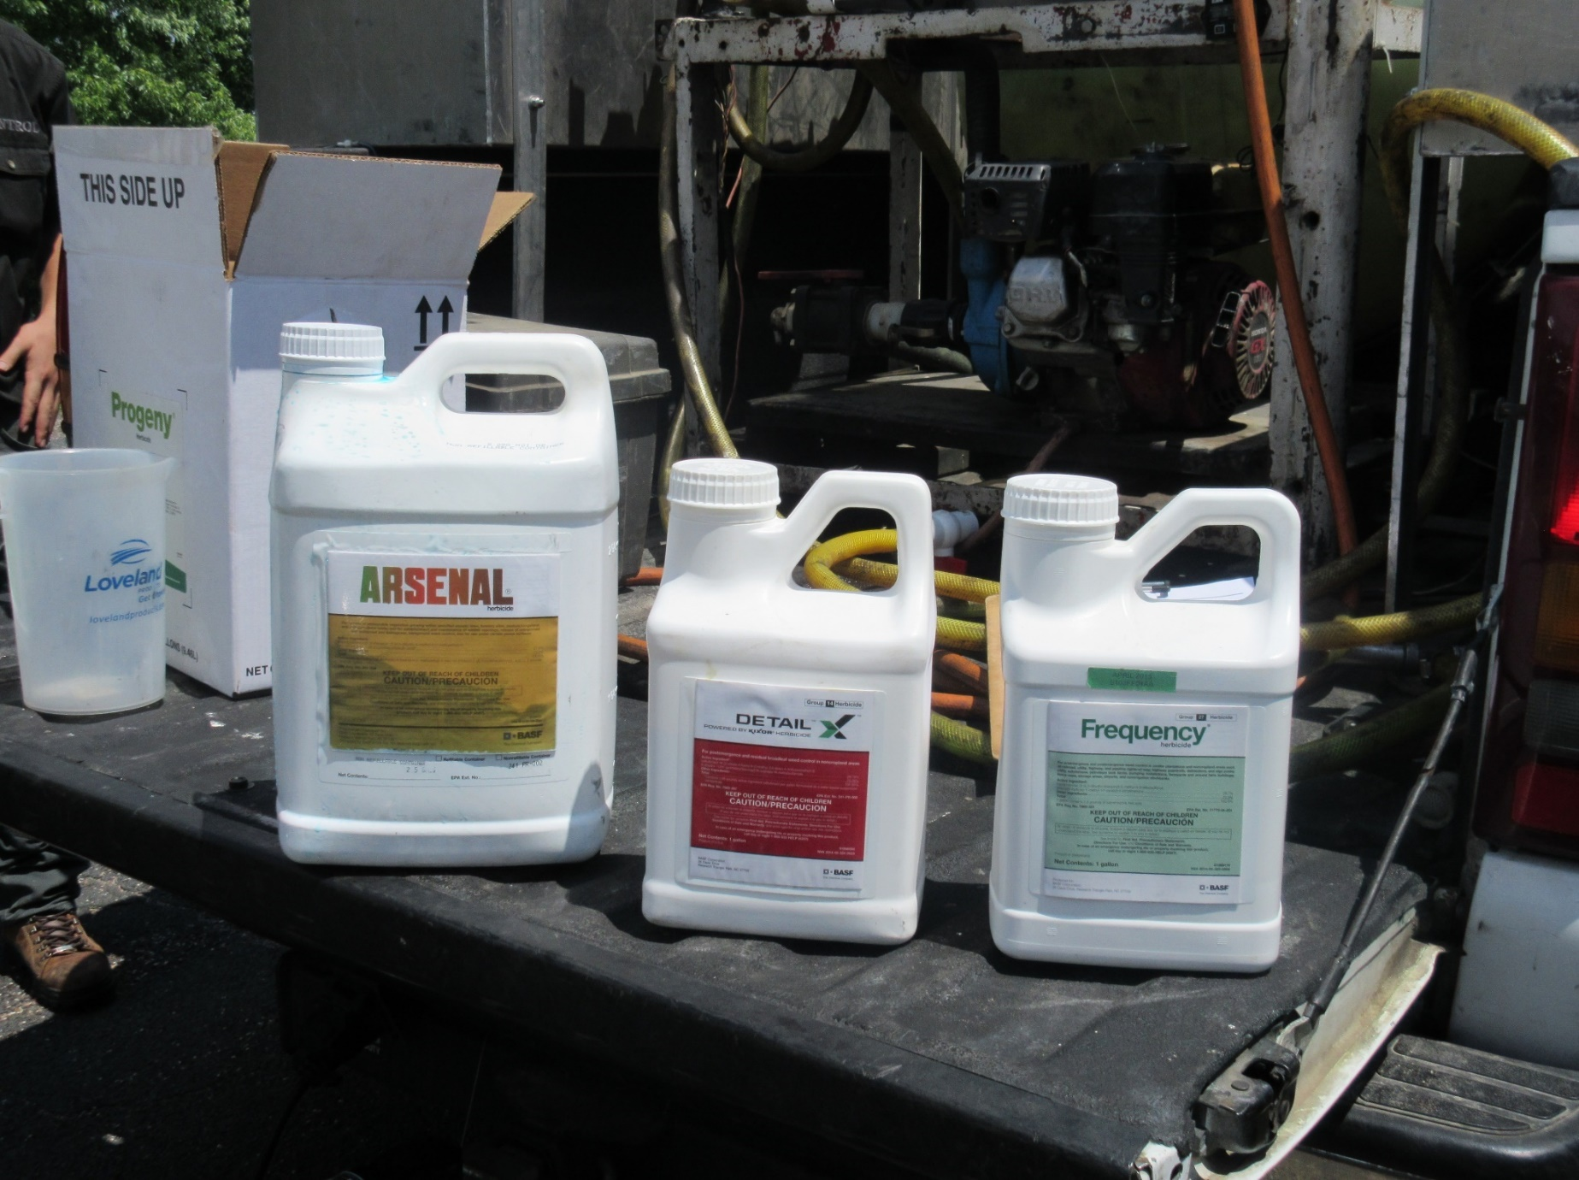
The Value of Branded Products
Product data
Technical expertise
Support
Custom blends
Claim resolution
Minimal price difference

Slide 19
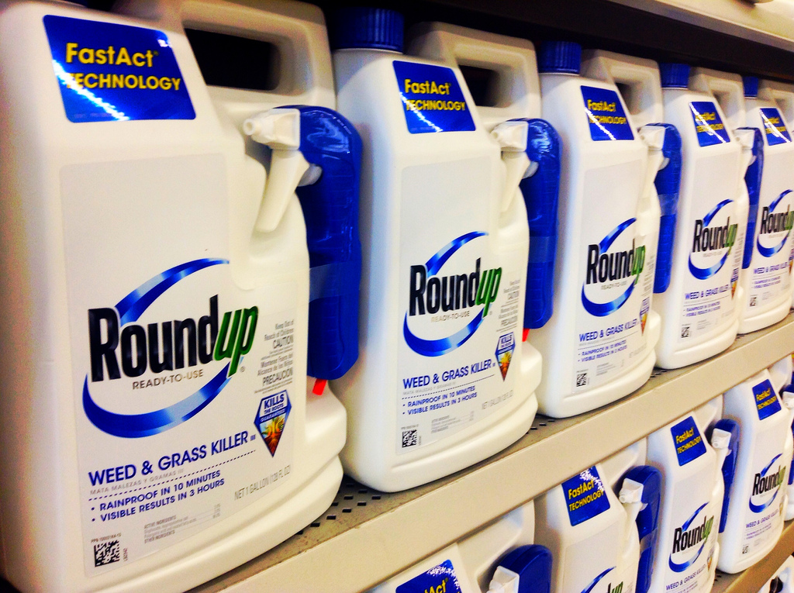
This Photo by Unknown Author is licensed under CC BY
Notes:
Disclaimer: BASF has never made glyphosate
Registered in 1974
Three different assessment – 74, 87, 16 Not Likely To Be Carcinogenic To Humans
2015:
International Agency For Research on Cancer (a subdivision of WHO) - determined Probable Carcinogen
European Food Safety Authority – Determined unlikely to pose acarcinogenic hazards to humans
2016
Joint Food and Agriculture Association another subdivision of WHO – Concluded glyphosate was unlikely to pose a carcinogenic risk to humans from exposure thru diet
EPA again concludes Not Likely To Be Carcinogenic To Humans

Slide 20
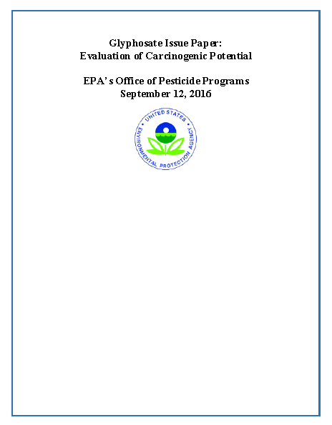
Evaluated 130 studies related to cancer
No data to support listing as a carcinogen when looking at all data
Two jury trial verdicts
Draw your own conclusions
This Photo by Unknown Author is licensed under CC BY

Slide 21

Invasive Species
Widespread problem
Growing exponentially
Aggressive invaders outcompete native vegetation
Form monocultures
Many burn very hot
Difficult to control without injury to desirable plants

Slide 22
New Products
Milestone, Vastlan, Freelex - Corteva
Method, Esplande - Bayer
Detail, Frequency, Finale VU, Clearcast, Oasis - BASF

Slide 23
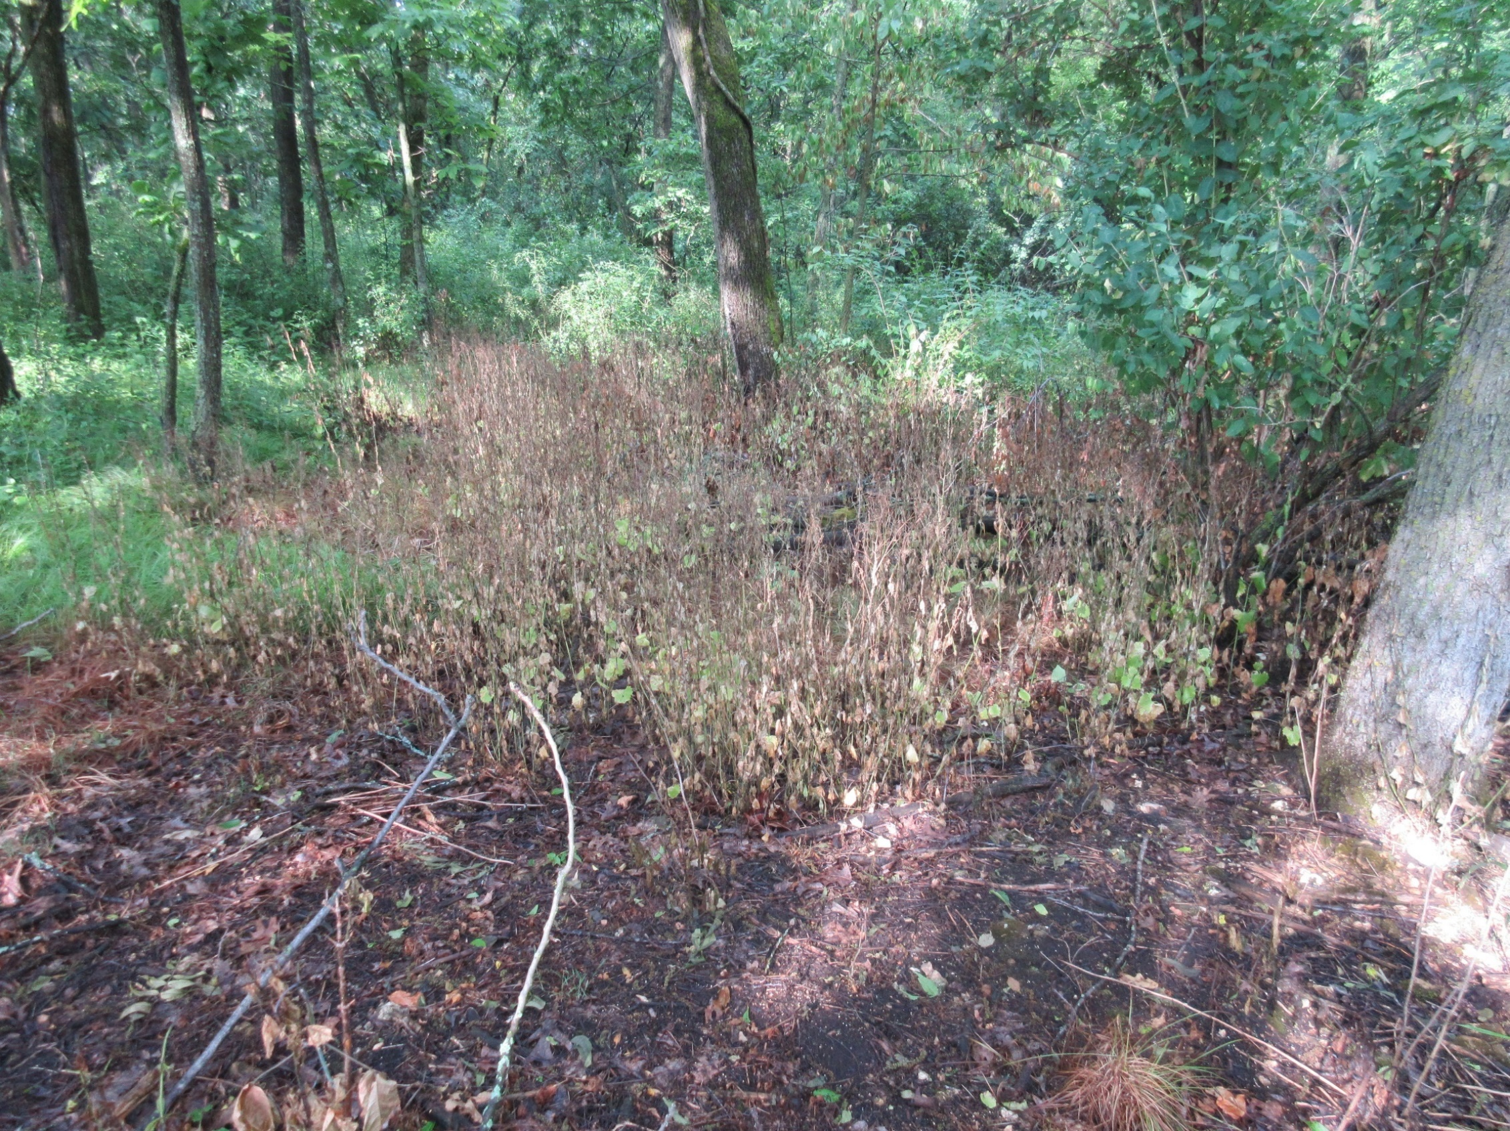
Detail®
Powered by Kixor® herbicide
Post-emergent selective broadleaf weed control
Kochia, Russian thistle, Garlic mustard, wild parsnip, pigweed, marestail
Excellent tank-mix partner for resistant weeds

Slide 24
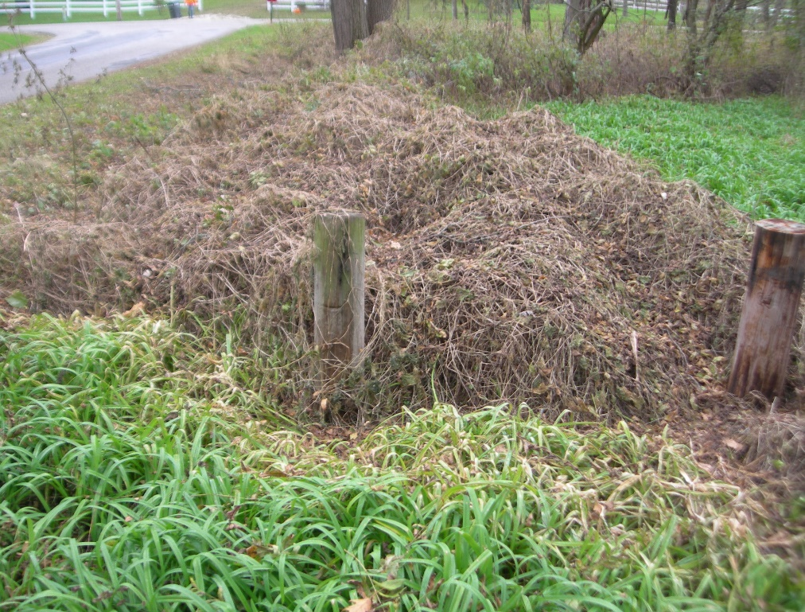

Detail®
Powered by Kixor® herbicide
Manchu Tubergourd Control
2 oz. Detail 50 gpa

Slide 25
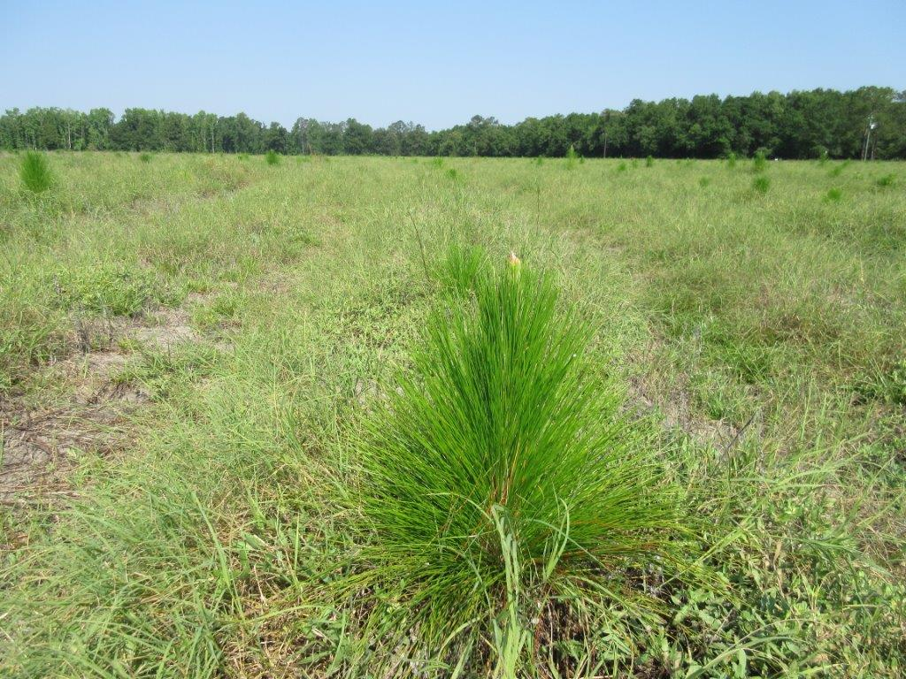
Frequency® herbicide
Pre-emergent control of pigweed, marestail, Bermudagrass and more
Longleaf pine establishment

Slide 26
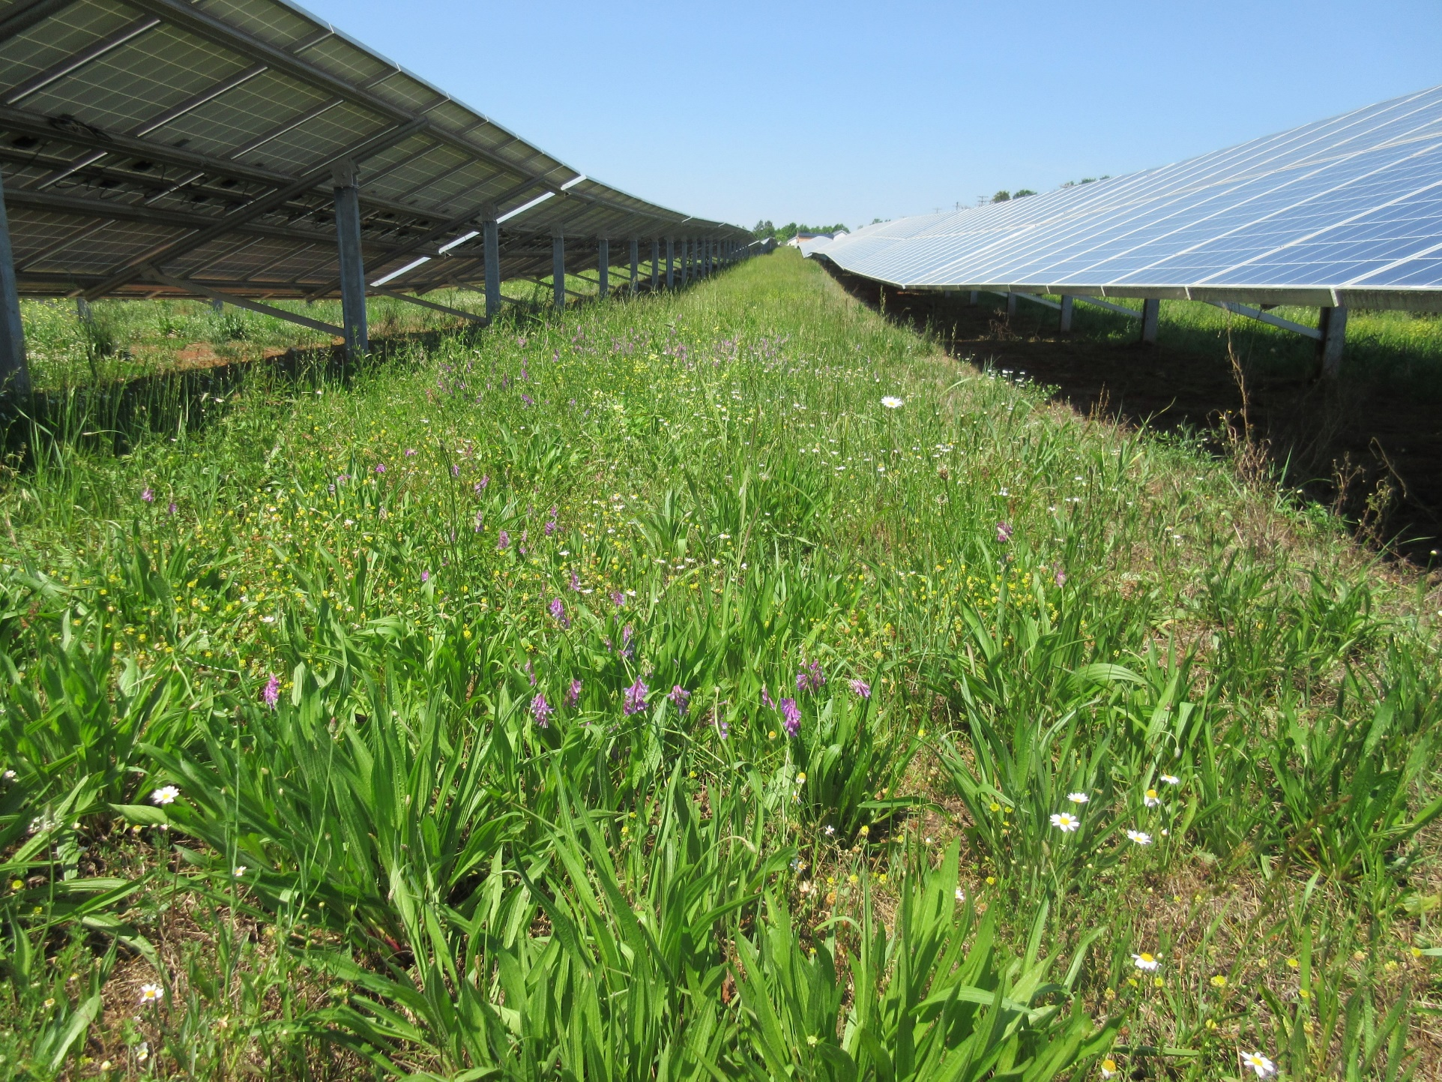
Plateau® herbicide
Leading herbicide for native grass restoration
Selective weeding
Growth suppression
Pasture and Rangeland

Slide 27
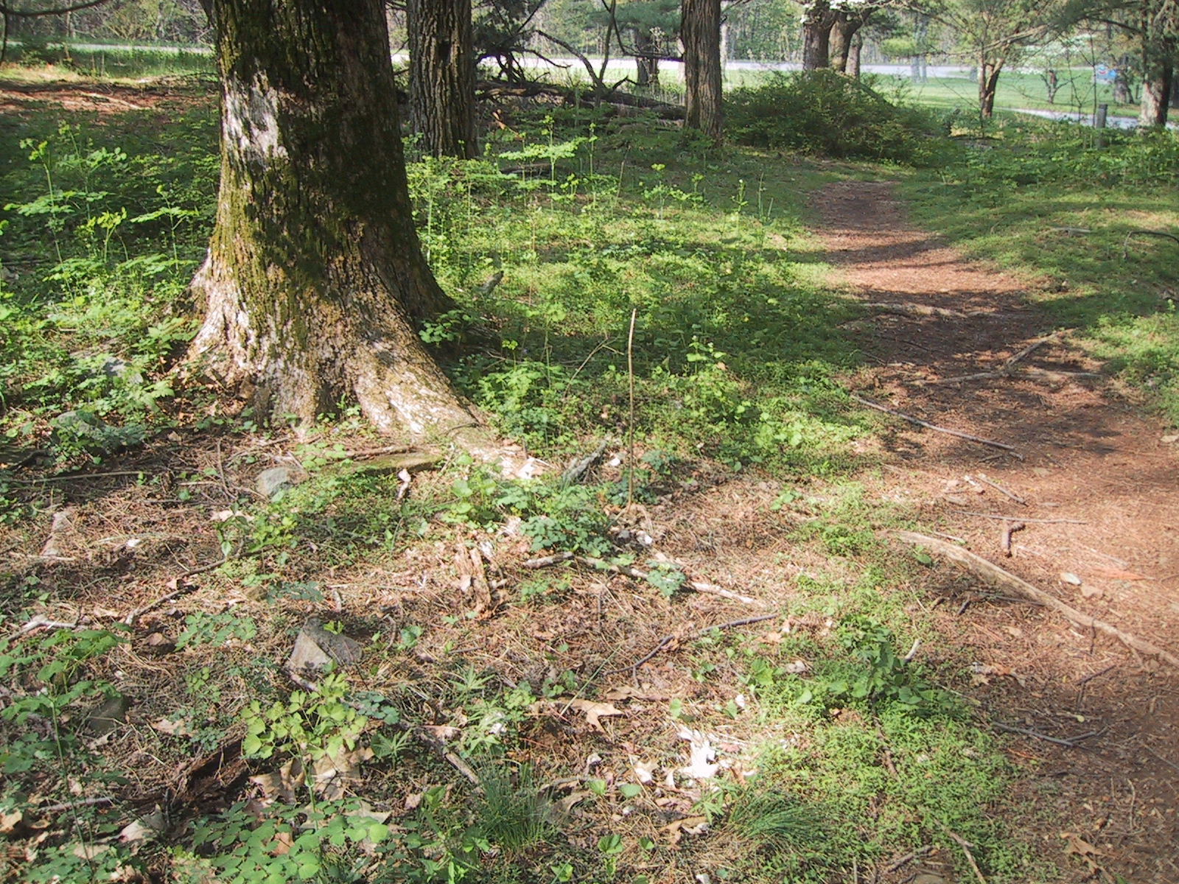
Japanese Stiltgrass Control
Shenandoah NP
Check
Photo May 16th
6 oz. Plateau Pre-emergent application
March 28th

Slide 28
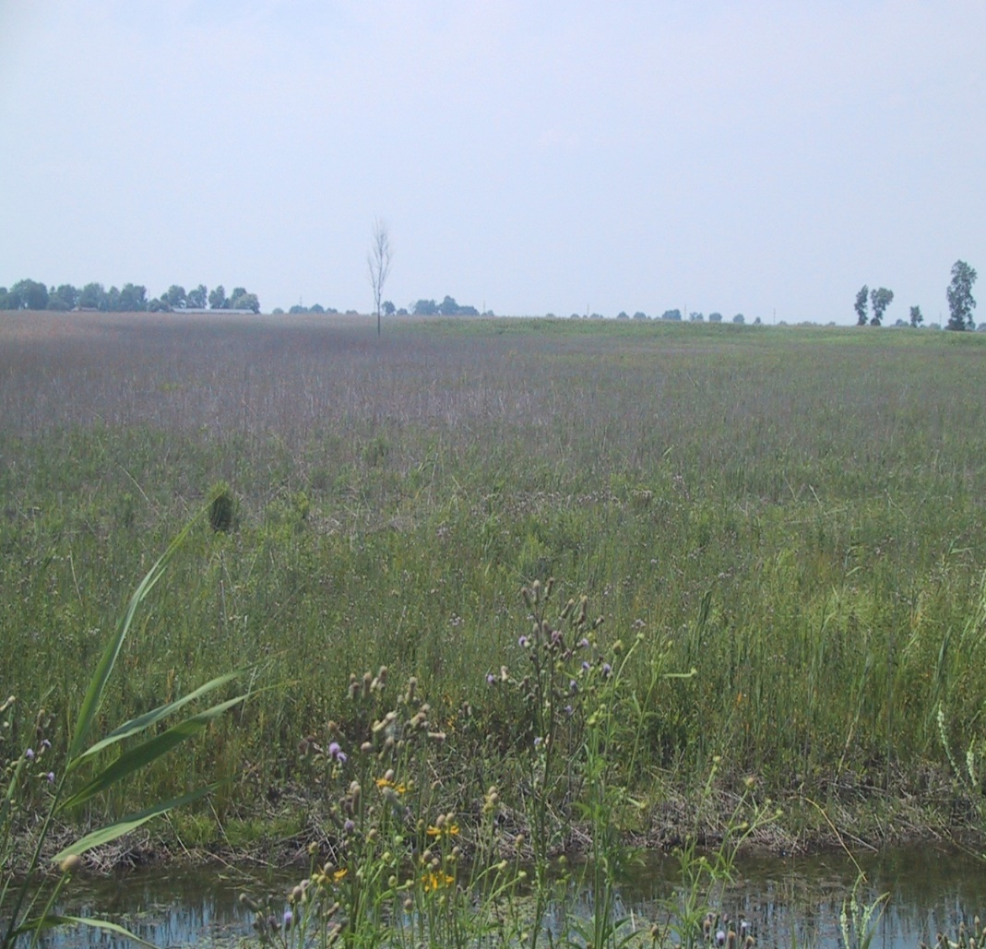
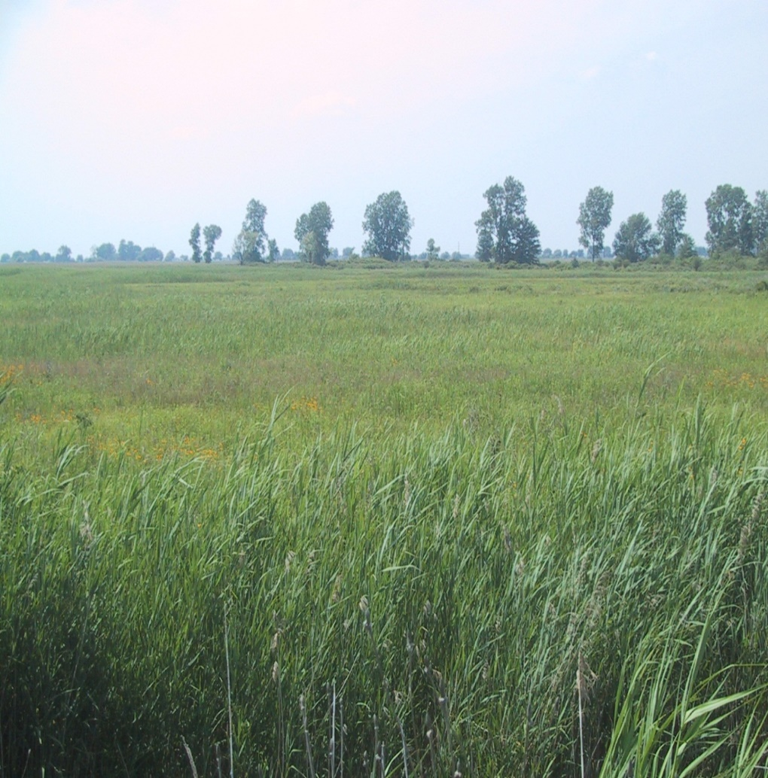
Phragmites Control
U.S. Army Corps of Engineers and USFWS
Arsenal® herbicide / Habitat ® herbicide
(3YAT)
Phragmites Control
Phragmites Regrowth
Habitat 64 oz.
Glyphosate 96 oz.
Habitat 64 oz.
St John’s Marsh, MI

Slide 29
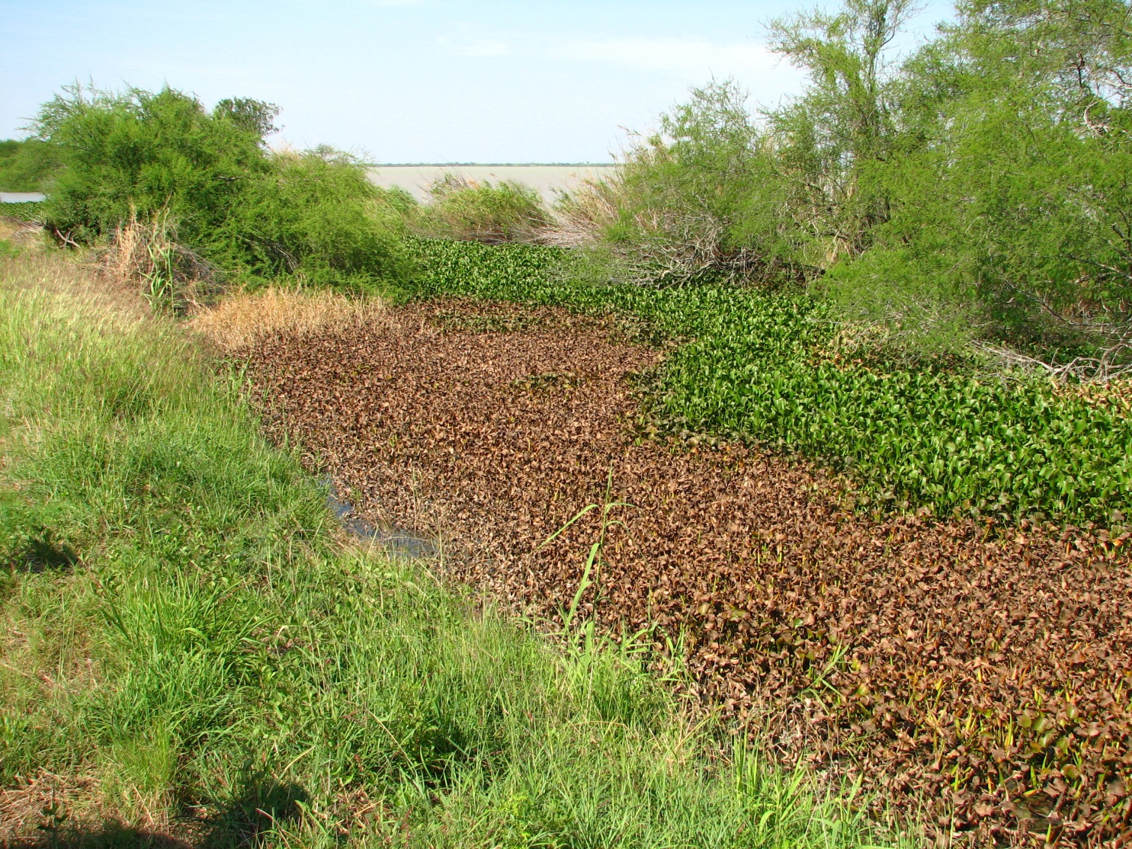
Clearcast® herbicide
Emerged aquatic and shoreline applications
Hydrilla, Cattails, Water hyacinth
Japanese stiltgrass

Slide 30
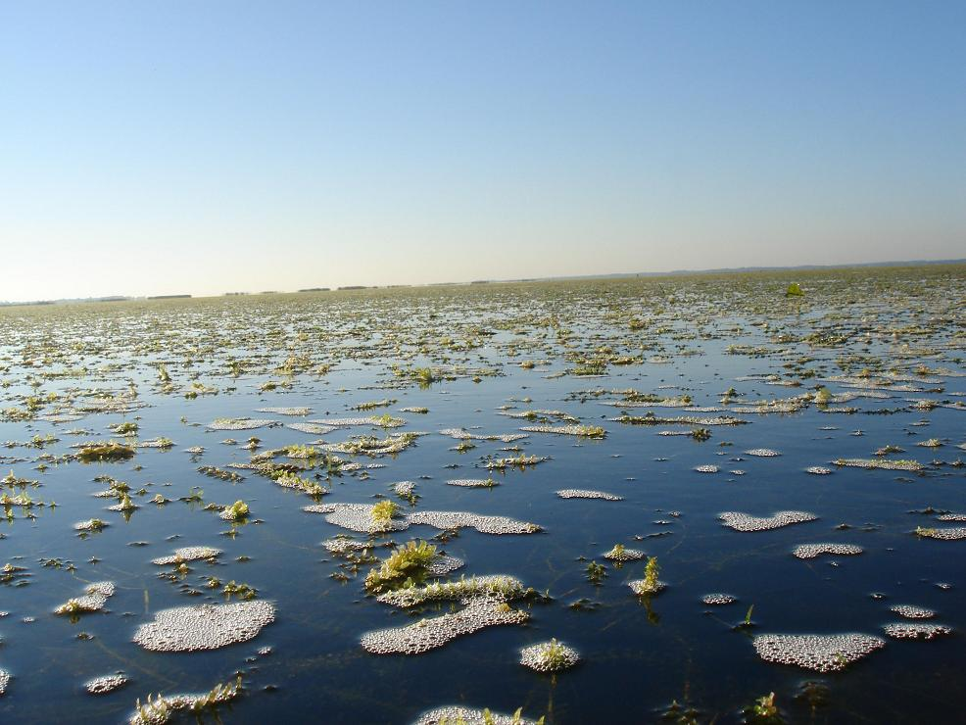
Oasis® herbicide
Labeled for submerged aquatics
Hydrilla control

Slide 31
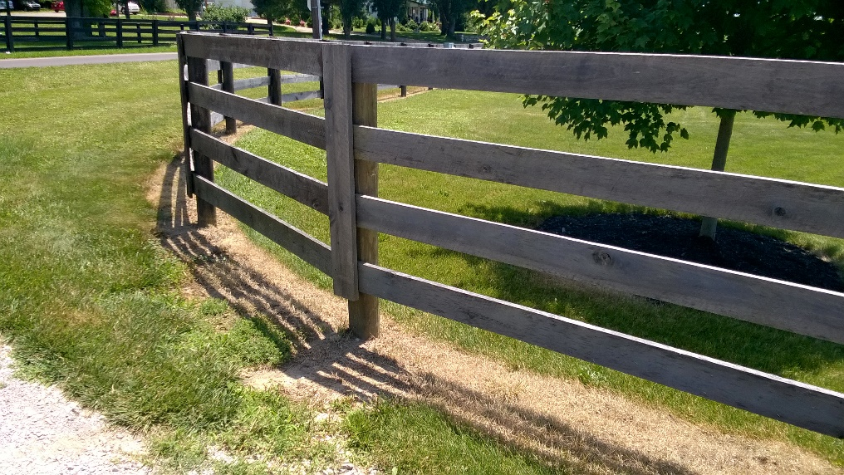
Finale® herbicide
Finale® VU herbicide
Glyphosate alternative
Postmergent control of glyphosate resistant weeds
No soil activity – can reseed immediately

Slide 32

Finale VU versus to Roundup Pro
Strength
Controls only what you spray
Symptoms in 1 to 4 days
Not sensitive to water hardness
Better results in cool weather
Much lower a.i. per acre
Great resistance mgt tool
Weakness
Does not translocate
No aquatic label
Not as effective on woody‘s and perennials
Warning label – eye irritation

Slide 33

2019 BASF Webinars
On Demand Sessions
    Tailored to your needs
    You chose the topic
    Very convenient way to educate

Slide 34

2019 BASF Podcasts
5 Minute Podcasts - Free
    Posted on the ProVM website
    Timely subjects

Slide 35
Contact
Jim Bean
901-496-2443
james.bean@basf.com
www.bettervm.basf.us
See the ProVM webpage for new podcasts!

Slide 36
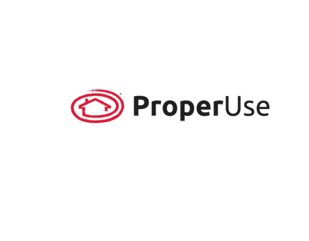
Product Stewardship is Everybody’s Responsibility
Always Read and Follow Label Directions.
Refer to Label for Registered Uses.
It is a violation of Federal law to use a product in a manner inconsistent with its labeling
All presentation information is property of BASF.
All product brand names and logos are registered trademarks or trademarks of BASF Corporation.

Slide 37
Thank You
Notes:
Thank you for your partnership and business.

Slide 38



